Slide 1

High-Speed FPGA Packet Processing using the new P4 Programming Language
FPGA 2018

Slide 2
Presenters
Gordon Brebner, Xilinx Labs
Stephen Ibanez, Stanford University

Slide 3
Agenda
Network data plane programming with P4
What is data plane programming?
P4: the data plane programming language
Break
Standard P4 design flow for software simulation target
FPGA implementation of P4
Xilinx P4-SDNet
P4→NetFPGA design flow
Future research directions

Slide 4
What is Data Plane Programming?
Why program the Data Plane?

Slide 5
Standard Telecommunications Architecture
Traditional architecture consists of the three planes
A Plane is a group of algorithms
These algorithms
Process different kinds of traffic
Have different performance requirements
Are designed using different methodologies
Are implemented using different programming languages
Run on different hardware
Management Plane
Configuration CLI/GUI/SNMP...
Control Plane
Protocol Stacks
BGP
ARP
PIM-SM
LLDP
IS-IS
OSPF
STP
Data Plane
Packet Forwarding
Notes:
When we discuss networking or telecommunications equipment, we often refer to the ”Three Planes, namely the Management Plane, the Control Plane and the Data Plane
We often use these terms, but if you try to Google them, it might be difficult to find a canonical defiinition.
Nevertheless, for our purposes we will define a Plane as a class (or a group) of algorithms. <click>
Traditionally, we distinguish between the three classes:
At the bottom if this diagram we have Data Plane (sometimes also referred to as Forwarding plane). These are the algorithms that process each and every data packet that ingresses or egresses the device. Obviously, these algorithms should be very fast and because of that they can‘t be very complicated. At modern networking speeds that reach multiple terabits per second for a given device, often the only way to implement these algorithms is by using a specialized device, an ASIC.
In the middle, we have the Control Plane. It processes a relatively small subset of all packets (i.e. the control packets), but employs vastly more complex algorithms and protocols to give a networking device its “intelligence”.
And on top we have the Management Plane, all the fancy GUIs and less fancy CLIs. There, the emphasis is not on speed, but on the ease of use and the looks.
Obviously, this is a very simplified picture. I intentionally omitted such important components as port management and platform management, because they are not directly related to packet processing.

Slide 6
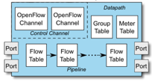
Software Defined Networking: Logically Centralized Control
Main contributions
OpenFlow = standardized model (“architecture”) defining switch behavior (match / action)
OpenFlow = standardized protocol to interact with switch (download flow table entries, query statistics etc.)
Concept of logically centralized control via a single entity (“SDN controller”)
Simplifies control plane – e.g. compute optimal paths at one location (controller), vs. waiting for distributed routing algorithms to converge
Issues
Limited interoperability between vendors => southbound I/F differences handled at controller (OpenFlow / netconf / JSON / XML variants)
Dataplane protocol evolution requires changes to standards (protocol and behavior)
Control Function (“App”)
x m
Northbound I/F
SDN Controller
x 1
Southbound I/F
x n
Switch

Slide 7
SDN Evolved: (Dataplane) Protocol Independence
Main contributions
Programs explicitly define dataplane protocols (parse tree)
Programs explicitly specify datapath behavior (matching, actions, queueing, global state…)
Issues
Enabling SDN controller (or its equivalent, e.g. OpenStack) to take advantage of new protocols / behaviors: more flexible NBI+SBI
Introduces new entities: DP program, DP programmer => new lifecycle issues arise
Ctl Func. (“Ctl App”)
Northbound I/F
SDN Controller
Southbound I/F
Compile+
download
Datapath_App.P4

Slide 8
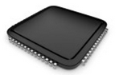
Status Quo: Bottom-up design
Switch OS
Network Demands
?
Run-time API
Driver
“This is how I know to
process packets”
(i.e. the ASIC datasheet
makes the rules)
Fixed-function ASIC
Notes:
To explain what data-plane programming is let me first describe how network systems are currently built
When you start building a network system you first define your list of requirements and the features you want to include
You then look at all of the different available packet-processing chips out there, which all have a datasheet that explains roughly in English how they process packets
You try to pick the one that best suits your needs, of course it also probably has a bunch of stuff you don’t need
But once you decide on a chip, that defines bottoms-up how your system will be built. It defines how the driver is written as well as how the control-plane running in the switch OS is able to interact with the forwarding plane in the fixed-function chip
Now of course, if you want to add a new feature, for example support a new protocol in your system, you need to change the fixed-function chip, which could take 4 years in the best case! And then after 4 years you’ve probably already figured out a hack to get around it, or if you do decide that still want it then you have to replace all of your hardware which is very expensive and can be big pain.
Now what P4 and this whole programmable data-plane movement are trying to do is turn this design philosophy upside down.

Slide 9

A Better Approach: Top-down design
Switch OS
Network Demands
Feedback
Run-time API
Driver
P4
“This is how I want the network to behave and how to switch packets…”
(the user / controller
makes the rules)
P4 Programmable Device
Notes:
What we really want is to be able to define at a high level exactly how the chip should process packets, which is done by writing a P4 program
That P4 program is then compiled down to the chip
This way network system designers get to define exactly what features they want to have in their system, without having to rely on third party chip vendors to make the decisions for them

Slide 10
Benefits of Data Plane Programmability
C
Control and Customization. Make the device behave exactly as you want
R
Reliability. Reduce the risk by removing unused features
E
Efficiency. Reduce energy consumption and expand scale by doing only what you need
A
Add new features on your schedule
T
Telemetry. Be able to see inside the Data Plane
E
Exclusivity and Differentiation. No need to share your IP with the chip vendor
Notes:
Why is it good and so important?
First of all, you will be able to make the device behave exactly as you want. Most of the time fixed function devices are designed around standard behaviors, because that’s what allows them to sell to most users. But any time you need to go outside of clearly prescribed behaviors (and, believe me, it happens a lot), it might be very difficult to do. When you write your own data plane program, you are free to do anything.
Second, you will be able to easily add new features at any time and without waiting for a new chip to be designed. How powerful is that? Imagine that you had to wait for a new CPU every time you wanted to write a new application!
And, by the way, if you have some ”secret sauce” you can keep it to yourself, because there is no need to explain anything to the chip vendor (who is most interested in the features that can be mande available to everyone).
Fourth, it is important to remember that high-speed ASICs, even programmable ones, have fixed, finite amount of resources. If a data plane program has to do a lot of things you do not need (which typically happens with a universal, “one-size-fits-all” programs), these resources, both silicon and energy are wasted on the things you don’t need. When you write your program, you can use generic resources, available on a programmable device only for the processing you need. If processing is simple, you can save energy or reduce latency as well.
Fifth, it might be a subtle point, but when you remove unused protocols, you are improving the overall reliability of the system, since you leave fewer holes in it.
And last, but not least, I will also show you that it is very easy to expose (and export the internal state of your data plane program outside. And this opens great opportunities in network telemetry and diagnostics that were simply unthinkable before.

Slide 11
Programmable Network Devices
PISA: Flexible Match+Action ASICs
Intel Flexpipe, Cisco Doppler, Cavium Xpliant, Barefoot Tofino, …
NPU
EZchip, Netronome, …
CPU
Open Vswitch, eBPF, DPDK, VPP,…
FPGA
Xilinx, Intel, …
These devices let us tell them how to process packets
Notes:
One of the great things about P4 is that it can be compiled to many different network devices
The Barefoot Tofino is a flexible Match+Action based ASIC that is programmable by P4
Netronome has a P4 and C based framework for programing their SmartNIC
There are P4 compilers for software switches such as Open vSwitch and VPP
And Xilinx has a P4 compiler for FPGAs, which has already been integrated into the workflow for programming the NetFPGA platform

Slide 12
What can you do with P4?
Layer 4 Load Balancer – SilkRoad[1]
Low Latency Congestion Control – NDP[2]
Fast In-Network cache for key-value stores – NetCache[3]
In-band Network Telemetry – INT[4]
Consensus at network speed – NetPaxos[5]
… and much more
[1] Miao, Rui, et al. "SilkRoad: Making Stateful Layer-4 Load Balancing Fast and Cheap Using Switching ASICs." SIGCOMM, 2017.
[2] Handley, Mark, et al. "Re-architecting datacenter networks and stacks for low latency and high performance.” SIGCOMM, 2017.
[3] Xin Jin et al. “NetCache: Balancing Key-Value Stores with Fast In-Network Caching.” SOSP, 2017
[4] Kim, Changhoon, et al. "In-band network telemetry via programmable dataplanes.” SIGCOMM, 2015.
[5] Dang, Huynh Tu, et al. "NetPaxos: Consensus at network speed.” SIGCOMM, 2015.
Notes:
Now what can you do with P4?
There are already a lot of interesting applications. Many of which have been published in high profile conferences such as SIGCOMM
SilkRoad, which is a stateful layer 4 load balancer implemented in hardware using the primitives provided by P4
NDP, which is a low latency congestion control algorithm for data centers
You can also implement a fast in-network cache for key-value stores
Or new telemetry techniques that provide unprecedented visibility into your network
Or you can even implement Paxos in your network
The list goes on…

Slide 13
Brief History and Trivia
May 2013: Initial idea and the name “P4”
July 2014: First paper (SIGCOMM ACR)
Aug 2014: First P4₁₄ Draft Specification (v0.9.8)
Sep 2014: P4₁₄ Specification released (v1.0.0)
Jan 2015: P4₁₄ v1.0.1
Mar 2015: P4₁₄ v1.0.2
Nov 2016: P4₁₄ v1.0.3
May 2017: P4₁₄ v1.0.4
Apr 2016: P4₁₆ – first commits
Dec 2016: First P4₁₆ Draft Specification
May 2017: P4₁₆ Specification released
Notes:
The ideas, surrounding the programmability of high-speed data planes appeared around 2013 <click> and in that same year the language name, which stands for Programming Protocol Packet Processors(P4) was coined
The language took its shape in 2014 <click>, and that’s when the first paper was published
Later, in that same year, the more formal and detailed public spec was released <click> along with the behavioral model and the compiler for it.
Since then there were minor spec revisions and amendments, but the language is quite stable and is supported on a number of targets
The idea of P4_16 germinated for some time and in April 2016 the first versions of the draft spec and the new compiler were committed to Github. <click>
Since then the language and tools were in intensive development and the first public draft was released in 2016, in December.
As many of you are probably aware, as of May 2017 the P4_16 language specification has been released and the p4-spec Github repository became publicly available.
A couple of words about versioning. Once P4_16 started to take shape, the original P4 became P4_14. We took our clues from a number of programming languages, such as C, C++, Fortran and Algol before them, noticing that the language that tend to have more independent implementations often use the year, while the languages with one dominant implementation tend to use regular version that corresponds to the version of that implementation. For P4 The version naming is based on the year of the original inception and then it takes about a year to finalize the spec. We support two versions of spelling: one for the terminals and “normal” programming work and a fancy one for the printed publications. Obviously, if you are familiar with TEX, you know that the underscore is the subscript indicator, so it is critically important to use underscore and not dash between “P4” and “16” (or 14 for that matter)

Slide 14
P4₁₆ Data Plane Model
Notes:
We will start with the basic P4 building blocks

Slide 15
PISA: Protocol-Independent Switch Architecture
Programmer defines the tables and the exact processing algorithm
Programmer declares how the output packet will look on the wire
Programmer declares the headers that should be recognized and their order in the packet
Programmable Match-Action Pipeline
Programmable Parser
Programmable Deparser
Memory
ALU
Match+ActionStage (Unit)
Notes:
In order to design a programming language, it is very useful to settle on the abstract machine, that is suited for the algorithms we'd like to express.
P4 is based on the abstract model of a high-speed packet processing device, called PISA, which stands for Protocol-Independent Switch Architecture. It served as a basis for P4_14 so we will first look at this classis and then see how P4_16 was able to expand on that idea.
PISA incorporates four basic components:
<click>
First, it is a programmable parser, which determines, which packet headers will be recognized by the data plane program. It is modeled as a simple, deterministic state machine, that consumes packet data and identifiers headers. It transitions between states typically by looking at specific fields in the previously identified headers. For example: The first 14 bytes are an Ethernet header. Then, if you look at the Ethertype, you know that the next header is a VLAN tag, an IPv4 or IPv6 header, an MPLS label, etc. If a parser identified an IPv4 header, it can jump to the next state based on IP protocol and so on.
At the heart of the PISA architecture is a pipeline, consisting of a set of stages that perform the same fundamental operation, that we call “Match – Action”. These stages are identical, hardware-wise and do not anything about protocols. What they can do is to match some data against a table that contains some entries and execute a corresponding action. If you think about it, that’s pretty much all the networking devices do. For example, an L2 switch will use a Destination MAC address (and a VLAN) to perform a match in an L2 table and then execute an action, such as “send a packet to this egress port”. Similarly, L3 switching is also easily reduced to a sequence of matches, such as Destination IP address lookup will produce a NexthopID and a lookup on a Nexthop ID will produce actions, such as “send to port”, :change MAC address”, “decrement TTL”, etc. ACLs, MPLS switching, everything can be expressed this way. Even basic things like if() or switch() statements can also be reduced to the basic operation of match and Action.
At the end of the pipeline, there is a programmable deparser that performs (as its name says)the operation, which is a reverse of the parsing. It re-assembles the packets back (e.g., by serializing the headers) so that the packets can go back onto the wire, into the queueing/replication engine etc.
The last important component is a mechanism through which the data (e.g. the intermediate results) are passed from one component to the other. It is schematically represented as arrows in this drawing, but in the real system it could be a very wide dedicated bus, shared memory/registers or something else. This is probably the most critical component, since without it nothing will work. As we will see later, the rest are optional.

Slide 16
PISA in Action
Packet is parsed into individual headers (parsed representation)
Headers and intermediate results can be used for matching and actions
Headers can be modified, added or removed
Packet is deparsed (serialized)
Programmable Match-Action Pipeline
Programmable Parser
Programmable Deparser
Match+ActionStage (Unit)
Notes:
The way PISA operates is quite straightforward (both figuratively and literally).
First, a packet arrives at the parser, which splits it into the individual headers, according to the parser program.
Then the parsed headers are passed into the match-action pipeline that matches either the headers or the intermediate results against match-action tables and performs a variety of operations:
For example it can remove or add headers
It can freely move the data between the headers, the intermediate results and the device state (represented here as tables)
It can perform both simple arithmetic and more specialized operations
Last, the deparser serializes the remaining headers back into the packet byte-stream

Slide 17
Mapping a Simple L3 Data Plane Program on PISA
IPv4
L2
ACL
IPv6
Programmable Match-Action Pipeline
Programmable Parser
Programmable Deparser
Ethernet
MAC
Address
Table
IPv4
Address Table
IPv6
Address Table
ACL
Rules
Match+ActionStage (Unit)
Notes:
Again, the device is actually totally unaware of what it is doing. It is the P4 programmer, aided by the compiler that programs the device so that it actions make sense from the protocol processing point of view.
For example, given (a very schematically drawn program for basic L3 processing) the compiler can choose to map it onto a pipeline this way.

Slide 18
Mapping a More Complex Data Plane Program on PISA
IPv4
L2
MPLS
ACL
IPv6
Programmable Match-Action Pipeline
Programmable Parser
Programmable Deparser
Ethernet
MAC
Address
Table
MPLS Table
IPv4
Address Table
ACL
Rules
IPv4
Address Table
IPv6
Address Table
Match+ActionStage (Unit)
Notes:
Again, the device is actually totally unaware of what it is doing. It is the P4 programmer, aided by the compiler that programs the device so that it actions make sense from the protocol processing point of view.
For example, given (a very schematically drawn program for basic L3 processing) the compiler can choose to map it onto a pipeline this way.

Slide 19
P4₁₄ Switch Model (V1 Architecture)
Ingress Pipeline
Egress Pipeline
Traffic Manager
N:1 Relationships: Queueing, Congestion Control
1:N Relationships: Replication
Scheduling
Implicitly Programmable Deparser
Programmable Parser
Packet Queuing, Replication & Scheduling
Ingress pipeline
Egress pipeline
Notes:
To build a real switch, we typically need <click> both an ingress and an<click> egress pipeline and Queueing/Replication engine between them. <click>
P4_14 specification explicitly prescribes the following model, which looks like an extended PISA pipeline with the non-P4 programmable Packet Queueing Replication and Scheduling block spliced in.
Or. if you want you can think of it as two PISA pipelines, one with the deparser chopped off and another one with the parser chopped off being joined together by Packet Queueing, Replication and Scheduling block.
Also, those of you familiar with P4_14 know that the deparser is implicitly programmable.
However, this is not the only architecture that is possible

Slide 20

P4₁₆ Approach
Term | Explanation
P4 Target | An embodiment of a specific hardware implementation
P4 Architecture | A specific set of P4-programmable components, externs, fixed components and their interfaces available to the P4 programmer
P4 Platform | P4 Architecture implemented on a given P4 Target
Community-Developed
Vendor-supplied
P4₁₆
Language
Extern Libraries
Architecture Definition
P4₁₆ Core Library
Notes:
One of the greatest innovations P4_16 takes a very radical position: all architectures must be supported! And it does this by doing two things:
First, it generalizes the notion of the pipeline and
Second, it removes the description of the “standard” pipeline architecture from the specification.
This makes the language much smaller and more generic, applicable to all architectures.
Basically, the community and develops and standardizes the language itself and the core library of the specialized objects that must always be present. <click>
The vendors of the specific devices provide the architecture definitions for their platforms and the libraries of externs that they support. <click>
Since we do have community-developed targets as well, some of these architectures will be community developed.

Slide 21
Programming a P4 Target
User supplied
Control Plane
P4 Program
P4 Compiler
Add/remove table entries
Extern control
Packet-in/out
RUNTIME
CPU port
P4 Architecture
Model
Data Plane
Target-specific configuration binary
Tables
Extern
objects
Load
Target
Vendor supplied

Slide 22
P4₁₆ Basics

Slide 23
P4₁₆ Language Elements
Parsers
State machine, bitfield extraction
Controls
Tables, Actions, control flow statements
Expressions
Basic operations and operators
Data Types
Bistrings, headers, structures, arrays
Architecture Description
Programmable blocks and their interfaces
Extern Libraries
Support for specialized components
Notes:
P4 has 6 different categories of language elements that allow us to fully program flexible pipelines.
At the base, there is a system of types that describes everything that the programmable components can operate on and, quite importantly how the information is transferred within them or between them.
P4 also supports expressions and simple, “non-looping” control statements that can be used pretty much everywhere as long as the target has the right capabilities
Controls represent imperative, sequential programming model. Represent the processing, done by the match-action units, but also are used to represent packet reassembly and other types of processing.
Parsers require different programming style. Their execution is best represented as a state machine
These are language elements that are found in the user programs. In addition to that, there are two classes of language elements that are used in the files that are written by the vendors. There are:
The descriptions of the particular pipeline: what programmable blocks does it contain <click> and what their interfaces <click> are
The declarations of the specialized processing elements that can’t otherwise be expressed in the language.

Slide 24
V1Model Standard Metadata
struct standard_metadata_t {
bit<9> ingress_port;
bit<9> egress_spec;
bit<9> egress_port;
bit<32> clone_spec;
bit<32> instance_type;
bit<1> drop;
bit<16> recirculate_port;
bit<32> packet_length;
bit<32> enq_timestamp;
bit<19> enq_qdepth;
bit<32> deq_timedelta;
bit<19> deq_qdepth;
bit<48> ingress_global_timestamp;
bit<32> lf_field_list;
bit<16> mcast_grp;
bit<1> resubmit_flag;
bit<16> egress_rid;
bit<1> checksum_error;
}
ingress_port - the port on which the packet arrived
egress_spec - the port to which the packet should be sent to
egress_port - the port on which the packet is departing from (read only in egress pipeline)
Notes:
Here on the left I am showing a list of the various standard metadata fields defined for the V1Model.
I’ll point out some of the most commonly used fields
The ingress_port is set by the simple_switch target and indicates the port on which the packet arrived
The egress_spec field should be set in the ingress pipeline to tell the traffic manager which port to send the packet to
The egress_port can be read within the egress pipeline, and indicates which port the packet is departing from
There are also many other fields here that can be used by P4 programs that target the V1Model
****
Need to define externs for the V1Model as well?

Slide 25
P4₁₆ Program Template (V1Model)
#include <core.p4>
#include <v1model.p4>
/* HEADERS */
struct metadata { ... }
struct headers {
ethernet_t ethernet;
ipv4_t ipv4;
}
/* PARSER */
parser MyParser(packet_in packet,
out headers hdr,
inout metadata meta,
inout standard_metadata_t smeta) {
...
}
/* CHECKSUM VERIFICATION */
control MyVerifyChecksum(in headers hdr,
inout metadata meta) {
...
}
/* INGRESS PROCESSING */
control MyIngress(inout headers hdr,
inout metadata meta,
inout standard_metadata_t std_meta) {
...
}
/* EGRESS PROCESSING */
control MyEgress(inout headers hdr,
inout metadata meta,
inout standard_metadata_t std_meta) {
...
}
/* CHECKSUM UPDATE */
control MyComputeChecksum(inout headers hdr,
inout metadata meta) {
...
}
/* DEPARSER */
control MyDeparser(inout headers hdr,
inout metadata meta) {
...
}
/* SWITCH */
V1Switch(
MyParser(),
MyVerifyChecksum(),
MyIngress(),
MyEgress(),
MyComputeChecksum(),
MyDeparser()
) main;
Notes:
Here is a template for a typical P4 program written for the V1Model
At the top of the file, we must include core.p4 because it defines some of the common types that are used in all P4 programs
<click> We also must include v1model.p4, which provides the definition of the V1Model architecture and also declares the various externs that can be used for this target; such as counters, meters, and registers
<click> A P4 program typically begins by declaring the format of various packet headers and building the headers and metadata structs. These structs are passed from block to block, along with the standard_metadata, as the packet traverses the architecture
Subsequently, the P4 source file (or files) must define the functionality for the parser
<click> checksum verification block
<click> ingress match-action processing
<click> egress match-action processing
<click> checksum update block
<click> deparser
<click> And finally, the P4 program must instantiate an instance of the architecture called main.
Let’s now take a look at the most basic example of a P4 program

Slide 26
P4₁₆ Hello World (V1Model)
#include <core.p4>
#include <v1model.p4>
struct metadata {}
struct headers {}
parser MyParser(packet_in packet,
out headers hdr,
inout metadata meta,
inout standard_metadata_t standard_metadata) {
state start { transition accept; }
}
control MyVerifyChecksum(inout headers hdr, inout metadata meta) { apply { } }
control MyIngress(inout headers hdr,
inout metadata meta,
inout standard_metadata_t standard_metadata) {
apply {
if (standard_metadata.ingress_port == 1) {
standard_metadata.egress_spec = 2;
} else if (standard_metadata.ingress_port == 2) {
standard_metadata.egress_spec = 1;
}
}
}
control MyEgress(inout headers hdr,
inout metadata meta,
inout standard_metadata_t standard_metadata) {
apply { }
}
control MyComputeChecksum(inout headers hdr, inout metadata meta) {
apply { }
}
control MyDeparser(packet_out packet, in headers hdr) {
apply { }
}
V1Switch( MyParser(), MyVerifyChecksum(), MyIngress(), MyEgress(), MyComputeChecksum(), MyDeparser() ) main;
Notes:
This is what I like to call the Hello World example for P4 programs. It is essentially just a wire that connects port 1 to port 2.
For this example, the parser does not need to extract any headers from the packet. It simple accepts and the packet is passed along to MyVerifyChecksum() block, which also does not need to do anything.
<click> When the packet reaches the MyIngress() block, the P4 program checks the port on which the packet arrived by reading the ingress_port field of the standard_metadata bus and decides which port to send the packet to using a simple if, else-if statement.
The rest of the blocks do not need to do anything and at the end of the program we instantiate the switch.
As you can see, all packets that arrives on port 1 will be sent to port 2 and all packets that arrive on port 2 will be sent to port 1
In this example, the connection between port 1 and port 2 is hardcoded and cannot be changed after the P4 program is compiled. Let’s see how we can make the switch a bit more flexible

Slide 27
P4₁₆ Hello World (V1Model)
#include <core.p4>
#include <v1model.p4>
struct metadata {}
struct headers {}
parser MyParser(packet_in packet, out headers hdr,
inout metadata meta,
inout standard_metadata_t standard_metadata) {
state start { transition accept; }
}
control MyIngress(inout headers hdr, inout metadata meta,
inout standard_metadata_t standard_metadata) {
action set_egress_spec(bit<9> port) {
standard_metadata.egress_spec = port;
}
table forward {
key = { standard_metadata.ingress_port: exact; }
actions = {
set_egress_spec;
NoAction;
}
size = 1024;
default_action = NoAction();
}
apply { forward.apply(); }
}
control MyEgress(inout headers hdr,
inout metadata meta,
inout standard_metadata_t standard_metadata) {
apply { }
}
control MyVerifyChecksum(inout headers hdr, inout metadata meta) { apply { } }
control MyComputeChecksum(inout headers hdr, inout metadata meta) { apply { } }
control MyDeparser(packet_out packet, in headers hdr) {
apply { }
}
V1Switch( MyParser(), MyVerifyChecksum(), MyIngress(), MyEgress(), MyComputeChecksum(), MyDeparser() ) main;
Key | Action Name | Action Data
1 | set_egress_spec | 2
2 | set_egress_spec | 1
Notes:
This design achieves the exact same functionality as what we just saw, but rather than using the if, else-if statement in the MyIngress control block, it uses a single table, called forward.
The forward table matches on the ingress_port field, and can invoke either the set_egress_spec action, or NoAction.
The table entries specify which action to take, along with any input parameters, for different ingress_port values.
We will explain P4 tables in more detail shortly.
By writing our P4 program in this way, we have created a much more flexible switch because now we can add and remove table entries from the control plane to determine how to to route packets between the various ports. And we can do this without changing the P4 program at all.

Slide 28
P4₁₆ Data Types
Basic Data Types
Derived Data Types
Headers and metadata

Slide 29
Simple Header Definitions
Example: Declaring L2 headers
header ethernet_t {
bit<48> dstAddr;
bit<48> srcAddr;
bit<16> etherType;
}
header vlan_tag_t {
bit<3> pri;
bit<1> cfi;
bit<12> vid;
bit<16> etherType;
}
struct my_headers_t {
ethernet_t ethernet;
vlan_tag_t[2] vlan_tag;
}
Basic Types
bit<n> – Unsigned integer (bitsrting) of length n
bit is the same as bit<1>
int<n> – Signed integer of length n (>=2)
varbit<n> – Variable-length bitstring
Derived Types
header – Ordered collection of members
Byte-aligned
Can be valid or invalid
Can contain bit<n>, int<n> and varbit<n>
struct – Unordered collection of members
No alignment restrictions
Can contain any basic or derived types
Header Stacks -- arrays of headers
Notes:
Let us declare the most familiar header – the ethernet header. Here we use the most important and the most basic type, bit<N>. There are some other basic types as well, int<n> and varbit<n>.
Signed integers are used much more rarely and we’ll cover varbits in a moment.
Header is a derived type. <click>
It describes the size of the fields, but also their order on the wire. <click>
Heades must be byte-aligned <click>
Let’s define another header, that I am sure you are all famil

Slide 30
Typedef
Example: Declaring a type for MAC address
typedef bit<48> mac_addr_t;
header ethernet_t {
mac_addr_t dstAddr;
mac_addr_t srcAddr;
bit<16> etherType;
}
Basic Types
bit<n> – Unsigned integer (bitsrting) of length n
bit is the same as bit<1>
int<n> – Signed integer of length n (>=2)
varbit<n> – Variable-length bitstring
Derived Types
header – Ordered collection of members
Byte-aligned
Can be valid or invalid
Can contain bit<n>, int<n> and varbit<n>
struct – Unordered collection of members
No alignment restrictions
Can contain any basic or derived types
Header Stacks -- arrays of headers
typedef – An alternative name for a type
Notes:
We can make our definitions even more readable (and less error prone) by using the typedef construct.

Slide 31
Varbit
Example: Declaring IPv4 header
typedef bit<32> ipv4_addr_t;
header ipv4_t {
bit<4> version;
bit<4> ihl;
bit<8> diffserv;
bit<16> totalLen;
bit<16> identification;
bit<3> flags;
bit<13> fragOffset;
bit<8> ttl;
bit<8> protocol;
bit<16> hdrChecksum;
ipv4_addr_t srcAddr;
ipv4_addr_t dstAddr;
}
header ipv4_options_t {
varbit<320> options;
}
Basic Types
bit<n> – Unsigned integer (bitsrting) of length n
bit is the same as bit<1>
int<n> – Signed integer of length n (>=2)
varbit<n> – Variable-length bitstring
Derived Types
header – Ordered collection of members
Byte-aligned
Can be valid or invalid
Can contain bit<n>, int<n> and varbit<n>
struct – Unordered collection of members
No alignment restrictions
Can contain any derived types
Header Stacks -- arrays of headers
typedef – An alternative name for a type
Notes:
Let’s see one more example of a header definition.
Note, by the way that you do not have to declare headers in P4 to correspond exactly to how they are defined in the standard. We will later see that sometimes it might be advantageous to split the definition into multiple P4 headers or to parse only the beginning of the header.
Obviously, you can expand the structure my_headers_t. Will you be able to do that? Sure!

Slide 32
Using structs for Intrinsic Metadata
typedef bit<9> port_id_t; /* Switch port */
typedef bit<16> mgid_t; /* Multicast Group */
typedef bit<5> qid_t; /* Queue ID */
struct parser_input_t {
port_id_t ingress_port;
bit<1> resubmit_flag;
}
struct ingress_input_t {
portid_t ingress_port;
timestamp_t ingress_timestamp;
}
struct ingress_output_t {
portid_t egress_port;
mgid_t mcast_group;
bit<1> drop_flag;
qid_t egress_queue;
}
Intrinsic Metadata is the data that a P4-programmable components can use to interface with the rest of the system
These definitions come from the files, supplied by the vendor
P4 Platform
parser_ input_t
ingress_ input_t
ingress_ output_t

Slide 33
Declaring and Initializing Variables
bit<16> my_var;
bit<8> another_var = 5;
const bit<16> ETHERTYPE_IPV4 = 0x0800;
const bit<16> ETHERTYPE_IPV6 = 0x86DD;
ethernet_t eth;
vlan_tag_t vtag = { 3w2, 0, 12w13, 16w0x8847 };
In P4₁₆ you can instantiate variables of both base and derived types
Variables can be initialized
Including the composite types
Constant declarations make for safer code
Infinite width and explicit width constants
Better than #define!
Safe constants with explicit widths

Slide 34
Programming the Parser

Slide 35
Parser Model (V1 Architecture)
#include <core.p4>
#include <v1model.p4>
/* User-defined inputs and outputs */
struct my_headers_t {
ethernet_t ethernet;
vlan_tag_t[2] vlan_tag;
ipv4_t ipv4;
ipv6_t ipv6;
}
struct my_metadata_t {
/* Nothing yet */
}
/* System-provided inputs. Others to follow */
struct standard_metadata_t {
bit<9> ingress_port;
. . .
}
/* Parser Declaration */
parser MyParser(packet_in packet,
out my_headers_t hdr,
inout my_metadata_t meta,
inout standard_metada_t standard_metadata)
{
. . .
MyParser
packet_in
hdr
The platform Initializes User Metadata to 0
meta
meta
standard_metadata
9
ingress_port
Notes:
Before we can write the parser, we need to understand how it is represented in P4_16. Again, the specific representation depends on the architecture, so let’s see how parsers look in P4D2 architecture, designed for this class.
In general, the idea is that the parser takes the input packet and returns a user-defined structure with the headers you, the user might be interested in.
Before we can declare anything, we need to include the standard P416 core library, i.e. the file, named “core.p4”. It is this file that declares a special extern object that represents a packet that we will be parsing.
We also need to include the description of the architecture we are writing for, in this case P4D2.
We’ve already declared the struct, representing the user headers, so I am going just to repeat it here. This is the bare minimum.
But, there is more! Our P4D2 architecture is also designed to provide the ingress port as one of the input for the parser. The following structure is defined in p4d2model.p4 and it will be the input to the parser too.
Also, as a nod to P4_14, P4D2 architecture also allows the user metadata to be passed through the parser. Before it enters the parser, the platform will initialize it to 0

Slide 36
Parsers in P4₁₆
Parsers are special functions written in a state machine style
Parsers have three predefined states
start
accept
reject
Can be reached explicitly or implicitly
What happens in reject state is defined by an architecture
Other states are user-defined
start
accept
reject

Slide 37
Implementing Parser State Machine
parser MyParser(packet_in packet,
out my_headers_t hdr,
inout my_metadata_t meta,
in standard_metadata_t standard_metadata)
{
state start {
packet.extract(hdr.ethernet);
transition select(hdr.ethernet.etherType) {
0x8100 &&& 0xEFFF : parse_vlan_tag;
0x0800 : parse_ipv4;
0x86DD : parse_ipv6;
0x0806 : parse_arp;
default : accept;
}
}
state parse_vlan_tag {
packet.extract(hdr.vlan_tag.next);
transition select(hdr.vlan_tag.last.etherType) {
0x8100 : parse_vlan_tag;
0x0800 : parse_ipv4;
0x86DD : parse_ipv6;
0x0806 : parse_arp;
default : accept;
}
}
state parse_ipv4 {
packet.extract(hdr.ipv4);
transition select(hdr.ipv4.ihl) {
0 .. 4: reject;
5: accept;
default: parse_ipv4_options;
}
state parse_ipv4_options {
packet.extract(hdr.ipv4.options,
(hdr.ipv4.ihl - 5) << 2);
transition accept;
}
state parse_ipv6 {
packet.extract(hdr.ipv6);
transition accept;
}
Notes:
Here we will complete the state machine and we are done!

Slide 38
Selecting on Multiple fields. Parsing ARP
const bit<16> ARP_HTYPE_ETHERNET = 0x0001;
const bit<16> ARP_PTYPE_IPV4 = 0x0800;
const bit<8> ARP_HLEN_ETHERNET = 6;
const bit<8> ARP_PLEN_IPV4 = 4;
state parse_arp {
packet.extract(hdr.arp);
transition select(hdr.arp.htype,
hdr.arp.ptype,
hdr.arp.hlen,
hdr.arp.plen) {
(ARP_HTYPE_ETHERNET,
ARP_PTYPE_IPV4,
ARP_HLEN_ETHERNET,
ARP_PLEN_IPV4) : parse_arp_ipv4;
default : accept;
}
}
state parse_arp_ipv4 {
packet.extract(hdr.arp_ipv4);
transition accept;
}
}
These definitions should go in the beginning of the parser function or in the top-level
Internet Protocol (IPv4) over Ethernet ARP packet
octet offset | 0 | 1
0 | Hardware type (HTYPE). (Ethernet = 0x0001)
2 | Protocol type (PTYPE) (IPv4 = 0x0800)
4 | Hardware address length (HLEN) | Protocol address length (PLEN)
6 | Operation (OPER)
8 | Sender hardware address (SHA) (first 2 bytes)
10 | (next 2 bytes)
12 | (last 2 bytes)
14 | Sender protocol address (SPA) (first 2 bytes)
16 | (last 2 bytes)
18 | Target hardware address (THA) (first 2 bytes)
20 | (next 2 bytes)
22 | (last 2 bytes)
24 | Target protocol address (TPA) (first 2 bytes)
26 | (last 2 bytes)
hdr.arp
hdr.arp_ipv4
Notes:
Here we will implement a parser for ARP packets. Notice that the ARP header has a protocol-independent and protocol-dependent portions. Therefore for P4 purposes it is better to split it in two. In our case we will only be concerned with ARP-IPv4.
So, first we will extract the protocol-independent portion <click> and only after checking that this is Ethernet/IPv4 ARP we will go further. This requires checking 4 fields and what you see is a construct called tuple that allows us to conveniently select on multiple fields.
Also, you might wonder, where these nice constants are coming from. Obviously, I could have used #define’s since P4 uses C preprocessor, but in P4_16 we have a very convenient construct, called const, which works as expected. The only thing is that these definitions should go a little higher, either in the beginning of the parser function MyParser() or in the toplevel.

Slide 39
Header verification
/* Standard errors, defined in core.p4 */
error { NoError, // no error PacketTooShort, // not enough bits in packet for extract NoMatch, // match expression has no matches StackOutOfBounds, // reference to invalid element of a header stack OverwritingHeader, // one header is extracted twice HeaderTooShort, // extracting too many bits in a varbit field ParserTimeout // parser execution time limit exceeded }
/* Additional error added by the programmer */
error { IPv4BadHeader }
. . .
state parse_ipv4 {
packet.extract(hdr.ipv4);
verify(hdr.ipv4.version == 4, error.IPv4BadHeader);
verify(hdr.ipv4.ihl >= 5, error.IPv4BadHeader);
transition select(hdr.ipv4.ihl) {
5: accept;
default: parse_ipv4_options;
}
. . .
Notes:
It is not uncommon to receive malformed packets in the network. We all know that there are a variety reasons for that.
These are a couple of ways how you can use the parser to mark the unwanted packets early or parse packets wisely.
As you remember, I mentioned that there are two terminal states for a parser: accept and reject. So far, the parser that we’ve written would end up transitioning only it into the accept state.
Transitioning into the reject state is rarely done explicitly. More often than not, it is done implicitly, more like an exception.
The main mechanism we use for that is the verify statement, which you can think of as a hybrid between assert() and throw(). Here is an example. First we define our own exceptions. There is a special error type for that in the language. You can define any number of these exceptions. If the condition in the verify() statement is not met, the parser will transition into the reject state and the error will be set.
There are a number of ways the transition into the reject state can happen implicitly. Errors for these cases are already defined in the core library.

Slide 40
Lookahead
Example: Typical MPLS Heuristic
header ip46_t { /* Common for both IPv4 and IPv6 */
bit<4> version;
bit<4> reserved;
}
state parse_mpls {
packet.extract(hdr.mpls.next);
transition select(hdr.mpls.last.bos) {
0: parse_mpls;
1: guess_mpls_payload;
}
}
state guess_mpls_payload {
transition select(packet.lookahead<ip46_t>().version) {
4 : parse_inner_ipv4;
6 : parse_inner_ipv6;
default : parse_inner_ethernet;
}
}
lookahead is a generic method
Compiler generates the method with the proper return type (ipv4_t) at the compile time
Returns the packet data without advancing the cursor
The packet length is still checked
Much safer and easier to use than bit offsets
Notes:
Here we declare a header that is common between IPv4 and IPv6 (both start with the nybble, indicating the protocol version).
One of the reasons for not using the real ipv4_t or ipv6_t is to avoid a condition, where we have less than 20 bytes of payload (in L2 case), but lookahed<ipv4_t> will singlal PacketTooShort error.

Slide 41
Programming the Match-Action Pipeline
Controls
Actions
Tables

Slide 42
Controls in P4
Very similar to C functions without loops
Algorithms should be representable as Direct Acyclic Graphs (DAG)
Represent all kinds of processing that are expressible as DAG:
Match-Action Pipelines
Deparsers
Additional processing (checksum updates)
Interface with other blocks via user- and architecture-defined data
Notes:
No loops or recursion, can only move forward
Sequential execution, if-statement, switch-statement, forward goto
Most pkt processing algs can be expressed as a DAG (except parsing): match-action, deparsing

Slide 43
Simple Reflector (V1 Architecture)
control MyIngress(
inout my_headers_t hdr,
inout my_metadata_t meta,
inout standard_metadata_t standard_metadata)
{
bit<48> tmp;
apply {
tmp = hdr.ethernet.dstAddr;
hdr.ethernet.dstAddr = hdr.ethernet.srcAddr;
hdr.ethernet.srcAddr = tmp;
standard_metadata.egress_spec =
standard_metadata.ingress_port;
}
}
hdr
hdr
meta
meta
standard_metadata
9
9
ingress_port
egress_spec
standard_metadata
mcast_grp
16
resubmit_flag
48
clone_spec
16
ingress_timestamp
resubmit_flag
egress_queue
5
Notes:
This program will swap src and dst MAC addresses then send pkt to same port on which it arrived
Interface definition, sits between parser and PRE
User defined hdrs and metadata – both input and output
std_metadata as per V1 Architecture, some fields are input some are output
Walk through program
Once the egress_spec field is set, the PRE (next slide) takes that and moves the pkt to the correct output port

Slide 44
How does it work? (V1 Architecture)
Packet Replication Engine
MyIngress()
MyEgress()
hdr
hdr
hdr
hdr
meta
meta
meta
meta
9
9
9
egress_port
ingress_port
egress_spec
16
16
egress_rid
resubmit_flag
mcast_grp
16
48
16
clone_id
16
clone_spec
16
clone_id
ingress_timestamp
packet_length
resubmit_flag
drop_flag
egress_queue
5
16
deq_qdepth
Notes:
So by setting certain std_metadata fields in the ingress control block you can configure the PRE to perform various functions
Move a single packet to single egress port
Mulitcast, etc.
This is for V1 Architecture, not all architectures must have a PRE or these std_metadata fields
We do not need to know implementation details of the PRE in order to use it in a P4 program
Interact with it by setting and reading metadata fields (and perhaps configuration from a control interface)

Slide 45
Simple Actions and Expressions
const bit<9> DROP_PORT = 511; /* Specific to V1 architecture */
action mark_to_drop() {
standard_metadata.egress_spec = DROP_PORT;
standard_metadata.mgast_grp = 0;
}
control MyIngress(inout my_headers_t hdr,
inout my_metadata_t meta,
inout standard_metadata_t standard_metadata)
{
/* Local Declarations */
action swap_mac(inout bit<48> dst, inout bit<48> src) {
bit<48> tmp;
tmp = dst; dst = src; src = tmp;
}
action reflect_to_other_port() {
standard_metadata.egress_spec =
standard_metadata.ingress_port ^ 1;
}
Very similar to C functions
Can be declared inside a control or globally
Parameters have type and direction
Variables can be instantiated inside
Standard Arithmetic and Logical operations are supported
+, -, *
~, &, |, ^, >>, <<
==, !=, >, >=, <, <=
No division/modulo
Additional operations:
Bit-slicing: [m:l]
Works as l-value too
Bit Concatenation: ++
/* Already defined in v1model.p4 */
Notes:
Let’s restructure our reflector program. We will do this by defining actions, which is quite similar to how functions are defined in C.
First is an action to drop packets. Specific to V1 Arch
Pkt only marked to be dropped
The next action, swap_mac will swap any 48-bit quantities.
Type and direction for parameters, possible directions: in, out, or inout
The last action is reflect_to_other_port()
It shows a simple use of an expression. The egress_spec is set to the ingress_port with the last bit inverted by using an XOR operation.
P4 supports numerous such operations

Slide 46
Simple Actions and Expressions
const bit<9> DROP_PORT = 511; /* V1 Architecure-specific */
action mark_to_drop() { /* Already defined in v1model.p4 */
standard_metadata.egress_spec = DROP_PORT;
standard_metadata.mgast_grp = 0;
}
control MyIngress(inout my_headers_t hdr,
inout my_metadata_t meta,
inout standard_metadata_t standard_metadata)
{
/* Local Declarations */
action swap_mac(inout bit<48> dst, inout bit<48> src) {
bit<48> tmp;
tmp = dst; dst = src; src = tmp;
}
action reflect_to_other_port() {
standard_metadata.egress_spec =
standard_metadata.ingress_port ^ 1;
}
/* The body of the control */
apply {
if (hdr.ethernet.dstAddr[40:40] == 0x1) {
mark_to_drop();
} else {
swap_mac(hdr.ethernet.dstAddr,
hdr.ethernet.srcAddr);
reflect_to_other_port();
}
}
}

Slide 47
Actions Galore: Operating on Headers
Example: Encapsulating IPv4 into a 2-label MPLS packet
header mpls_t {
bit<20> label;
bit<3> exp;
bit<1> bos;
bit<8> ttl;
}
action ipv4_in_mpls(in bit<20> label1, in bit<20> label2) {
hdr.mpls[0].setValid();
hdr.mpls[0].label = label1;
hdr.mpls[0].exp = 0;
hdr.mpls[0].bos = 0;
hdr_mpls[0].ttl = 64;
hdr.mpls[1].setValid();
hdr.mpls[1] = { label2, 0, 1, 128 };
if (hdr.vlan_tag.isValid()) {
hdr.vlan_tag.etherType = 0x8847;
} else {
hdr.ethernet.etherType = 0x8847;
}
}
Header Validity bit manipulation:
header.setValid() – add_header
header.setInvalid() – remove_header
header.isValid()
Header Assignment
From tuples
if() statements are allowed in actions too!
Notes:
What else can we do with actions?
Headers have a validity bit – actions to manipulate them, set by parser upon extraction
To add a header, setValid() then populate fields
To remove header setInvalid()
To check if header is valid

Slide 48
Actions Galore: Operating on Headers
action decap_ip_ip() {
hdr.ipv4 = hdr.inner_ipv4;
hdr.inner_ipv4.setInvalid();
}
action pop_mpls_label() {
hdr.mpls.pop_front(1);
}
action push_mpls_label(in bit<20> label, in bit<3> exp) {
hdr.mpls.push_front(1);
hdr.mpls[0].setValid();
hdr.mpls[0] = { label, exp, 0, 64 };
}
Header Validity bit manipulation:
header.setValid() – add_header
header.setInvalid() – remove_header
header.isValid()
Header Assignment
header = { f1, f2, ..., fn }
header1 = header2
Special operations on Header Stacks
In the parsers
header_stack.next
header_stack.last
header_stack.lastIndex
In the controls
header_stack[i]
header_stack.size
header_stack.push_front(int count)
header_stack.pop_front(int count)
Notes:
Another example of working with headers
Decapsulating IP in IP is pretty easy
And if we want to pop off an MPLS label,
Header stacks provide a convenient method for popping off the first element, pop_front
And for the reverse operation we can use push_front()

Slide 49
Actions Galore: Bit Manipulation
Example: Forming Ethernet MAC address for IPv4 Multicast Packets
action set_ipmcv4_mac_da_1() {
hdr.ethernet.dstAddr = 24w0x01005E ++ 1w0 ++
hdr.ipv4.dstAddr[22:0];
}
action set_ipmcv4_mac_da_2() {
hdr.ethernet.dstAddr[47:24] = 0x01005E;
hdr.ethernet.dstAddr[23:23] = 0;
hdr.ethernet.dstAddr[22:0] = hdr.ipv4.dstAddr[22:0];
}
Special Operations for bit manipulation:
Bit-string concatenation
Bit-slicing
Notes:
bit concatenation
bit slicing

Slide 50
Match-Action Tables
The fundamental units of the Match-Action Pipeline
What to match on and match type
A list of possible actions
Additional properties
Size
Default Action
Entries
etc.
Each table contains one or more entries (rows)
An entry contains:
A specific key to match on
A single action
to be executed when a packet matches the entry
(Optional) action data
Notes:
Match-action tables are probably the central construct of P4
Don’t have to use tables in P4 program, but compiler may map actions, if-statements, and branches in control flow to tables if that is what is provided by underlying target

Slide 51
Tables: Match-Action Processing
Control Plane
Headers and Metadata
Directional (DataPlane) Parameters
Lookup Key
Hit
Key | Action | Action Data
Action Code
Action
Directionless (Action Data) Parameters
Hit/Miss Selector
Data
Headers and Metadata
(Input)
Default Action | Default Action Data
Headers and Metadata
(Output)
Action Execution
Notes:
Table operation is relatively simple, yet powerful. The tables consist of entries that normammy contain a key, action and action data, although the key and the action data are optional. The entries is the table are populated by the control plane. It can also query them, of course.
The entries establish correspondence between the key and a given action plus action data. In addition to that, the control table can also specify the default action and the action data for it (if needed).
The process of match and actinon is called “applying a table”.
First the lookup key is formed. It can contain fields from any headers or any metadata. In fact, these can also be expressions.
Then, the actual lookup (match) happens. The results of the lookup are: the action and the action data and a hit indicator. If the match was successful, the action and the action data come from the table, otherwise it will be the default action/default action data.
Once selected, the action and the action data go into the action execution unit. In addition, all the headers and metadata are also available there. We will see it later, but it is very important to understand that actions operate on two very different classes of parameters: the data plane parameters (shown as light beige) and the action data parameter that come from the control plane (shown as green).
Finally, the results go into the headers or metadata. Since the input and output is always the same, tables can be joined in long processing chains very easily.

Slide 52





Example: Basic IPv4 Forwarding
192.168.1.1
192.168.23.45
Data Plane (P4) Program
Defines the format of the table
Key Fields
Actions
Action Data
Performs the lookup
Executes the chosen action
Control Plane (IP stack, Routing protocols)
Populates table entries with specific information
Based on the configuration
Based on automatic discovery
Based on protocol calculations
192.168.1.2
192.168.23.254
192.168.1.3
192.168.1.254
10.1.2.0/22
192.168.1.4
Key | Action | Action Data
192.168.1.1 | l3_switch | port= mac_da= mac_sa= vlan=
192.168.1.2 | l3_switch | port= mac_da= mac_sa= vlan=…
192.168.1.3 | l3_drop
192.168.1.254 | l3_l2_switch | port=
192.168.1.0/24 | l3_l2_switch | port=
10.1.2.0/22 | l3_switch_ecmp | ecmp_group=
Notes:
Take a moment to highlight the roles of the data-plane and control-plane
Control-plane provides runtime control of the P4 program

Slide 53
Defining Actions for L3 forwarding
action l3_switch(bit<9> port,
bit<48> new_mac_da,
bit<48> new_mac_sa,
bit<12> new_vlan)
{
/* Forward the packet to the specified port */
standard_metadata.metadata.egress_spec = port;
/* L2 Modifications */
hdr.ethernet.dstAddr = new_mac_da;
hdr.ethernet.srcAddr = mac_sa;
hdr.vlan_tag[0].vlanid = new_vlan;
/* IP header modification (TTL decrement) */
hdr.ipv4.ttl = hdr.ipv4.ttl – 1;
}
action l3_l2_switch(bit<9> port) {
standard_metadata.metadata.egress_spec = port;
}
action l3_drop() {
mark_to_drop();
}
Actions can use two types of parameters
Directional (from the Data Plane)
Directionless (from the Control Plane)
Actions that are called directly:
Only use directional parameters
Actions used in tables:
Typically use direction-less parameters
May sometimes use directional parameters too
Directional (DataPlane) Parameters
Action Code
Directionless (Action Data) Parameters
Action Execution
Notes:
Let us define actions used for L3 forwarding
Note that the parameters are directionless – come from the control-plane

Slide 54
Match-Action Table (Exact Match)
Example: A typical L3 (IPv4) Host table
table ipv4_host {
key = {
meta.ingress_metadata.vrf : exact;
hdr.ipv4.dstAddr : exact;
}
actions = {
l3_switch; l3_l2_switch;
l3_drop; noAction;
}
default_action = noAction();
size = 65536; }
These are the only possible actions. Each particular entry can have only ONE of them.
/* Defined in core.p4 */
action noAction() { }
vrf | ipv4.dstAddr | action | data
1 | 192.168.1.10 | l3_switch | port_id= mac_da= mac_sa=
100 | 192.168.1.10 | l3_l2_switch | port_id=<CPU>
1 | 192.168.1.3 | l3_drop
DEFAULT |  | noAction

Slide 55
Match-Action Table (Longest Prefix Match)
Example: A typical L3 (IPv4) Routing table
table ipv4_lpm {
key = {
meta.ingress_metadata.vrf : exact;
hdr.ipv4.dstAddr : lpm;
}
actions = {
l3_switch;
l3_l2_switch;
l3_switch_nexthop(meta.l3.nexthop_info);
l3_switch_ecmp(meta.l3.nexthop_info);
l3_drop; noAction;
}
const default_action = l3_l2_switch(CPU_PORT);
size = 16384; }
Different fields can use different match types
Prefix length also serves as a priority indicator
vrf | ipv4.dstAddr / prefix | action | data
1 | 192.168.1.0 / 24 | l3_l2_switch | port_id=3
10 | 10.0.16.0 / 22 | l3_ecmp | ecmp_index=12
1 | 192.168.0.0 / 16 | l3_switch_nexthop | nexthop_index=451
1 | 0.0.0.0 / 0 | l3_switch_nexthop | nexthop_index=1
DEFAULT |  | l3_l2_switch | port_id=CPU_PORT

Slide 56
Match-Action Table (Ternary Match)
Example: A more powerful L3 (IPv4) Routing table
table ipv4_lpm {
key = {
meta.ingress_metadata.vrf : ternary;
hdr.ipv4.dstAddr : ternary;
}
actions = {
l3_switch;
l3_l2_switch;
l3_switch_nexthop(meta.l3.nexthop_info);
l3_switch_ecmp(meta.l3.nexthop_info);
l3_drop;
noAction;
}
const default_action = l3_l2_switch(CPU_PORT);
size = 16384; }
Explicitly Specified Priority
Prio | vrf / mask | ipv4.dstAddr / mask | action | data
100 | 0x001/0xFFF | 192.168.1.5 / 255.255.255.255 | l3_swith_nexthop | nexthop_index=10
10 | 0x000/0x000 | 192.168.2.0/255.255.255.0 | l3_switch_ecmp | ecmp_index=25
10 | 0x000/0x000 | 192.168.3.0/255.255.255.0 | l3_switch_nexthop | nexthop_index=31
5 | 0x000/0x000 | 0.0.0.0/0.0.0.0 | l3_l2_switch | port_id=64
Notes:
change match type
Now the table contents are a bit more complicated because we have to specify a mask for each key
It is again, the control-plane’s job to configure the table entries

Slide 57
Using Tables in the Controls
control MyIngress(inout my_headers_t hdr,
inout my_metadata_t meta,
inout standard_metadata_t standard_metadata)
{
/* Declarations */
action l3_switch(...) { . . . }
action l3_l2_switch(...) { . . . }
. . .
table assign_vrf { . . . }
table ipv4_host { . . . }
table ipv6_host { . . . }
/* Code */
apply {
assign_vrf.apply();
if (hdr.ipv4.isValid()) {
ipv4_host.apply();
}
}
}
Declare Actions
Declaration is instantiation
Declare Tables
Declaration is instantiation
Apply() Tables – Perform Match-Action
Make sure the table matches on valid headers
Notes:
Now that we've seen how to declare tables, lets take a look at how to use them in a control block

Slide 58
Using the Match Results
apply {
. . .
if (hdr.ipv4.isValid()) {
if (!ipv4_host.apply().hit) {
ipv4_lpm.apply();
}
}
}
apply {
. . .
switch (ipv4_lpm.apply().action_run) {
l3_switch_nexthop: { nexthop.apply(); }
l3_switch_ecmp: { ecmp.apply(); }
l3_drop: { exit; }
default: { /* Not needed. Do nothing */ }
}
}
Apply method returns a special result:
A boolean, representing the hit
An enum, representing a selected action
Switch() statement
Only used for the results of match-action
Each case should be a block statement
Default case is optional
Means “any action” not “default action”
Exit and Return Statements
return – go to the end of the current control
exit – go to the end of the top-level control
Useful to skip further processing
Notes:
Table’s apply method returns two special objects that can useful for manipulating the control flow of your program
hit
action_run
Can also use return and exit as forward goto statements to skip additional processing

Slide 59
Match Kinds (types)
/* core.p4 */
match_kind {
exact,
ternary,
lpm
}
/* v1model.p4 */
match_kind { /* Augments the standard definition }
range,
selector
}
/* Some other architecture */
match_kind {
regexp,
range,
fuzzy,
telepathy
}
match_kind is a special type in P4
core.p4 defines three basic match kinds
Exact match
Ternary match
LPM match
Architectures can add their own match kinds

Slide 60
Advanced Matching
table classify_ethernet {
key = {
hdr.ethernet.dstAddr : ternary;
hdr.ethernet.srcAddr : ternary;
hdr.vlan_tag[0].isValid() : ternary;
hdr.vlan_tag[1].isValid() : ternary;
}
actions = {
malformed_ethernet;
unicast_untagged;
unicast_single_tagged;
unicast_double_tagged;
multicast_untagged;
multicast_single_tagged;
multicast_double_tagged;
broadcast_untagged;
broadcast_single_tagged;
broadcast_double_tagged;
}
Tables keys can be arbitrary expressions
Check header validity
header.isValid()
Use only important bits
header.field[msb:lsb]
hdr.ipv6.dstAddr[127:64] : lpm;
Fantasy is your limit:
hdr.ethernet.srcAddr ^ hdr.ethernet.dstAddr
Notes:
Table match keys can also be expressions
isValid() is popular because you don’t want to match on a header that is not valid

Slide 61
Table Initialization
/* Continued from previous slide */
const entries = {
/* { dstAddr, srcAddr, vlan_tag[0].isValid(), vlan_tag[1].isValid() } : action([action_data]) */
{ 48w000000000000, _, _, _ } : malformed_ethernet(ETHERNET_ZERO_DA);
{ _, 48w000000000000, _, _ } : malformed_ethernet(ETHERNET_ZERO_SA);
{ _, 48w010000000000 &&& 48w010000000000, _, _ } : malformed_ethernet(ETHERNET_MCAST_SA);
{ 48wFFFFFFFFFFFF, _, 0, _ } : broadcast_untagged();
{ 48wFFFFFFFFFFFF, _, 1, 0 } : broadcast_single_tagged();
{ 48wFFFFFFFFFFFF, _, 1, 1 } : broadcast_double_tagged();
{ 48w010000000000 &&& 48w010000000000, _, 0, _ } : multicast_untagged();
{ 48w010000000000 &&& 48w010000000000, _, 1, 0 } : multicast_single_tagged();
{ 48w010000000000 &&& 48w010000000000, _, 1, 1 } : multicast_double_tagged();
{ _, _, 0, _ } : unicast_untagged();
{ _, _, 1, 0 } : unicast_single_tagged();
{ _, _, 1, 1 } : unicast_double_tagged();
}
}
Notes:
Can initialize static table entries

Slide 62
Packet Deparsing
Notes:
So by now we’ve learned how to parse the packets, we’ve learned how to process the packets
Now we will learn how to deparse the packet

Slide 63
Deparsing
control MyDeparser(packet_out packet,
in my_headers_t hdr)
{
apply {
/* Layer 2 */
packet.emit(hdr.ethernet);
packet.emit(hdr.vlan_tag);
/* Layer 2.5 */
packet.emit(hdr.mpls);
/* Layer 3 */
/* ARP */
packet.emit(hdr.arp);
packet.emit(hdr.arp_ipv4);
/* IPv4 */
packet.emit(hdr.ipv4);
/* IPv6 */
packet.emit(hdr.ipv6);
/* Layer 4 */
packet.emit(hdr.icmp);
packet.emit(hdr.tcp);
packet.emit(hdr.udp);
}
}
Assembling the packet from headers
Expressed as another control function
No need for another construct
packet_out – defined in core.p4
emit(header) – serialize the header if it is valid
emit(header_stack) – serialize the valid elements in order
Advantages:
Decoupling of parsing and deparsing
Notes:
Deparsing is a very simple procedure, we just need to output the headers in the right order
Sequential so we can use control block
Core p4 lang defines packet_out – byte stream to assemble
Emit only inserts the header into the packet if it is valid. Can be header or header stack
A single packet will only have one of ARP, IPv4, or IPv6

Slide 64
Simplified Deparsing
struct my_headers_t {
ethernet_t ethernet;
vlan_tag_t [2] vlan_tag;
mpls_t [5] mpls;
arp_t arp;
arp_ipv4_t arp_ipv4;
ipv4_t ipv4;
ipv6_t ipv6;
icmp_t icmp;
tcp_t tcp;
udp_t udp;
}
control MyDeparser(packet_out packet,
in my_headers_t hdr)
{
apply {
packet.emit(hdr);
}
}
Simply keep the header struct organized
Headers will be deparsed in order
Notes:
Simplified even more
Will emit only headers that are valid in exactly the order that they are defined in the headers struct

Slide 65
Externs

Slide 66
The Need for Externs
Most platforms contain specialized facilities
They differ from vendor to vendor
They can’t be expressed in the core language
Specialized computations
They might have control-plane accessible state or configuration
The language should stay the same
In P4₁₄ almost 1/3 of all the constructs were dedicated to specialized processing
In P4₁₆ all specialized objects use the same interface
Objects can be used even if their implementation is hidden
Through instantiation and method calling
Notes:
Till now we’ve been mostly only using the core language features
Truth is, many devices have specialized components and functionality that cannot be expressed in P4 and differ from vendor to vendor
Special hash functions
Encryption
RegEx matching
Devices may have state that is accessible to the control-plane
Devices and functionality is exposed to P4 program using this extern mechanism
Externs are like black boxes to P4 program, they just see the interface, inputs and outputs

Slide 67
Stateless and Stateful Objects
Stateless Objects: Reinitialized for each packet
Variables (metadata), packet headers, packet_in, packet_out
Stateful Objects: Keep their state between packets
Tables
Externs
V1 architecture: Counters, Meters, Registers, Parser Value Sets, Selectors, etc.
Object | Data Plane Interface |  | Control Plane Can
 | Read State | Modify/Write State | Read | Modify/Write
Table | apply() | --- | Yes | Yes
Parser Value Set | get() | --- | Yes | Yes
Counter | --- | count() | Yes | Yes*
Meter | execute () |  | Configuration Only | Configuration Only
Register | read() | write() | Yes | Yes
Notes:
All objects in P4 can be divided in two big classes:
Stateless objects do not keep their state between packets. Metadata, headers
There are only two kinds of stateful objects in P4_16: tables and externs.
There are various generally useful stateful externs defined for the V1 Architecture, which have a certain data plane and control plane interface

Slide 68
Counters in V1 Architecture
/* Definition in v1model.p4 */
enum CounterType {
packets,
bytes,
packets_and_bytes
}
/* An array of counters of a given type */
extern counter {
counter(bit<32> instance_count, CounterType type);
void count(in bit<32> index);
}
Extern definition contains
The instantiation method
Has the same name as the extern
Is evaluated at compile-time
Methods to access the extern
Very similar to actions
Can return values too
Enums in P4₁₆
Abstract values
No specific (numerical representation)
Notes:
How counter extern is defined for V1 Arch

Slide 69
Using the V1 Architecture Counters
control MyIngress(inout my_headers_t hdr,
inout my_metadata_t meta,
inout standard_metadata_t standard_metadata)
{
counter(8192, CounterType.packets_and_bytes) ingress_bd_stats;
action set_bd(bit<16> bd, bit<13> bd_stat_index) {
meta.l2.bd = bd;
ingress_bd_stats.count((bit<32>)bd_stat_index);
}
table port_vlan {
key = {
standard_metadata.ingress_port : ternary;
hdr.vlan_tag[0].isValid() : ternary;
hdr.vlan_tag[0].vid : ternary;
}
actions = { set_bd; mark_for_drop; }
default_action = mark_for_drop();
}
apply {
port_vlan.apply();
. . .
}
}
Instantiate an extern inside the control
Call the instantiation method
Parameters must be known at compile-time
Use extern’s methods in actions or directly
counter ingress_bd_stats
0
pkt/byte counts
table port_vlan
Key
Action
Action Data
8191
ABCD_0123
set_bd
bd
bd_stat_index A
set_bd
bd
bd_stat_index
matched entry
set_bd
bd
bd_stat_index A
set_bd
bd
bd_stat_index
set_bd
bd
bd_stat_index
set_bd
bd
bd_stat_index B
BA8E_F007
set_bd
bd
bd_stat_index
69
Notes:
Suppose, we’d like to have a set of counters that will be incremented for some given flow. Perhaps, we want to count the packets.
First, let’s instantiate a counter array. We need to do do it inside some control, e.g .our MyIngress control function.
We write it as a call to the instantiation method with the parameters we like. In this particular case I just created an array of 1024 packet counters and this object will be called flow_counter. Besides the fact that the compiler will allocate proper resources, the fact that we give an object instantiation a name is extremely important. That means that the compiler will also be able to generate appropriate APIs to access this object.
Now, we can define an action that can increment the counter.

Slide 70
Meters in V1 Architecture
Definition
Usage
/* Definition in v1model.p4 */
enum MeterType {
packets,
bytes
}
extern meter {
meter(bit<32> instance_count, MeterType type);
void execute_meter<T>(in bit<32> index, out T result);
}
typedef bit<2> meter_color_t;
const meter_color_t METER_COLOR_GREEN = 0;
const meter_color_t METER_COLOR_YELLOW = 1;
const meter_color_t METER_COLOR_RED = 2;
meter(1024, MeterType.bytes) acl_meter;
action color_my_packets(bit<10> index) {
acl_meter.execute_meter((bit<32>)index, meta.color);
}
table acl {
key = { . . .}
actions = { color_my_packets; . . .}
}
apply {
acl.apply();
if (meta.color == METER_COLOR_RED) {
mark_to_drop();
}
}
This is a template definition. The method will accept the parameter of any type
Color Coding:
0 – Green
1 – Yellow
2 -- Red
Notes:
Meters are useful policing your traffic and doing rate limiting

Slide 71
Registers in V1 Architecture
Definition
Usage (Calculating Inter-Packet Gap)
/* Definition in v1model.p4 */
extern register<T> {
register(bit<32> instance_count);
void read(out T result, in bit<32> index);
void write(in bit<32> index, in T value);
}
register<bit<48>>(16384) last_seen;
action get_inter_packet_gap(out bit<48> interval,
bit<14> flow_id)
{
bit<48> last_pkt_ts;
/* Get the time the previous packet was seen */
last_seen.read(last_pkt_ts,
(bit<32>)flow_id);
/* Calculate the time interval */
interval = standard_metadata.ingress_global_timestamp –
last_pkt_ts;
/* Update the register with the new timestamp */
last_seen.write((bit<32>)flow_id,
standard_metadata.ingress_global_timestamp);
}
Notes:
Here I show the most generic universal stateful object, available in V1 architecture. It is called a “register” and it can store arbitrary data. This data can also be retrieved.
Registers are defined as being able to store values of any type, therefore the definition is templated. In reality, of course, there might be limitations. I can easily see registers being able to store bit<n> values up to a certain width, but storing a struct of headers might be more difficult.
In any case, when instantiating the register, we provide two arguments: one is the type of the values that will be stored and another one is the

Slide 72
Header Checksums (V1 Architecture)
IPv4 Checksum Verification
IPv4 Checksum Update
control MyVerifyChecksum(in my_headers_t hdr,
inout my_metadata_t meta)
{
Checksum16() ipv4_checksum;
bit<16> ck;
apply {
if (hdr.ipv4.isValid()) {
ck = ipv4_checksum.get(
{
hdr.ipv4.version, hdr.ipv4.ihl,
hdr.ipv4.diffserv, hdr.ipv4.totalLen,
hdr.ipv4.identification, hdr.ipv4.flags,
hdr.ipv4.fragOffset, hdr.ipv4.ttl,
hdr.ipv4.protocol, hdr.ipv4.srcAddr,
hdr.ipv4.dstAddr
});
if (hdr.ipv4.hdrChecksum != ck) {
mark_to_drop();
}
}
}
}
control MyComputeChecksum(inout my_headers_t hdr,
inout my_metadata_t meta)
{
Checksum16() ipv4_checksum;
apply {
if (hdr.ipv4.isValid()) {
hdr.ipv4.hdrChecksum = ipv4_checksum.get(
{
hdr.ipv4.version, hdr.ipv4.ihl,
hdr.ipv4.diffserv, hdr.ipv4.totalLen,
hdr.ipv4.identification, hdr.ipv4.flag,
hdr.ipv4.fragOffset, hdr.ipv4.ttl,
hdr.ipv4.protocol, hdr.ipv4.srcAddr,
hdr.ipv4.dstAddr
});
}
}
}
Notes:
Extern to calculate 16-bit checksums, useful for computing IPv4 checksum

Slide 73
Break

Slide 74
P4 Toolchain for BMv2 software simulation

Slide 75


Basic Workflow
simple_switch_CLI
test.p4
Program-independent CLI and Client
TCP Socket
(Thrift)
simple_switch (BMv2)
Program-independent Control Server
p4c-bm2-ss
test.json
PRE
Log
Ingress
Egress
Debug
P4 Debugger
test.json
test.json
Parser
Deparser
Packet generator
Port Interface
Packet sniffer
veth0..n
Linux Kernel

Slide 76
Step 1: P4 Program Compilation
test.p4
$ p4c-bm2-ss -o test.json test.p4
p4c-bm2-ss
test.json

Slide 77
Step 2: Preparing veth Interfaces
test.p4
$ sudo ~/p4lang/tutorials/examples/veth_setup.sh
# ip link add name veth0 type veth peer name veth1
# for iface in “veth0 veth1”; do
ip link set dev ${iface} up
sysctl net.ipv6.conf.${iface}.disable_ipv6=1
TOE_OPTIONS="rx tx sg tso ufo gso gro lro rxvlan txvlan rxhash”
for TOE_OPTION in $TOE_OPTIONS; do
/sbin/ethtool --offload $intf "$TOE_OPTION”
done
done
test.json
test.json
test.json
veth
0
2
4
2n
Linux Kernel
veth
1
3
5
2n+1

Slide 78
Step 3: Starting the model
$ sudo simple_switch --log-console --dump-packet-data 64 \
–i 0@veth0 -i 1@veth2 … [--pcap] \
test.json
test.p4
TCP Socket
(Thrift)
BMv2
Program-independent Control Server
PRE
Logging
Ingress
Egress
test.json
test.json
test.json
Parser
Deparser
Port Interface
veth0.pcap
veth0..n
Linux Kernel

Slide 79
Step 4: Starting the CLI
$ simple_switch_CLI
BMv2 CLI
Program-independent CLI and Client
TCP Socket
(Thrift)
test.p4
Program-independent Control Server
BMv2
test.json
PRE
Logging
test.json
Ingress
Egress
test.json
Parser
Deparser
test.json
Port Interface
veth0..n
Linux Kernel

Slide 80
Step 5: Sending and Receiving Packets
BMv2
Program-independent Control Server
test.json
PRE
Logging
scapy
p = Ethernet()/IP()/UDP()/”Payload”
sendp(p, iface=“veth0”)
Ethereal, etc..
Ingress
Egress
scapy
sniff(iface=“veth9”, prn=lambda x: x.show())
Wireshark, tshark, tcpdump
Packet Generator
Packet Sniffer
Parser
Deparser
Port Interface
veth
0
2
4
2n
Linux Kernel
veth
1
3
5
2n+1

Slide 81
Other tools
Mininet
On a single host, emulate a network of multiple devices with a set of interconnecting links that you configure.
P4 Runtime - A program independent (PI) API for
Loading P4 programs into devices
Adding and removing table entries
Configuring meters and other externs, reading counter statistics
Either locally or remotely, over a TCP socket using Google Protocol Buffers
p4-api working group is writing a spec and developing the code

Slide 82
Extending the tools
All are open source - https://github.com/p4lang
P4c compiler has multiple back ends already:
bmv2
EBPF – Extended Berkeley Packet Filter, running in Linux kernel
Xilinx FPGAs
Designed to add back ends for additional devices
Compiler internal documentation in docs directory of p4c Github repo
Portable Switch Architecture (PSA)
p4-arch working group is developing many useful P4_16 externs
Good reference for how to add your own

Slide 83
The p4c-sdnet Compiler

Slide 84


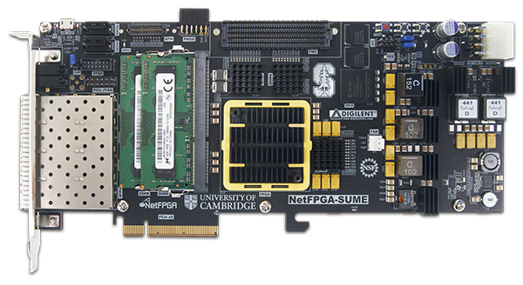

Xilinx SDNet Design Flow & Use Model
.sdnet
Firmware
Packet Processing Spec.
PX (domain specific language)
describe function in packet-oriented terms
HDL description
SDNet Compiler
Throughput & Latency
Resources
Programmability
Tailored Packet Processor

Slide 85
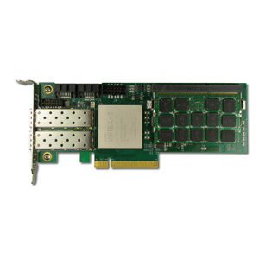
Xilinx P4 Design Flow & Use Model
Xilinx P4₁₆ Compiler
.p4
.sdnet
$ p4c-sdnet switch.p4
Verification Environment
Top level Verilog wrapper
Verilog Engines (Encrypted)
System Verilog Testbench
Lookup Engine C++ Drivers
High level C++ Testbench

Slide 86
Considerations When Mapping to SDNet
Identifying parallelism within P4 parser and control blocks
table lookups
actions
etc.
P4 packet processing model
extract entire header from packet
updates apply directly to header
deparser re-inserts header back into packet
SDNet packet processing model
stream packet through “engines”
modify header values in-line without removing and re-inserting

Slide 87
Mapping P4 Architectures to SDNet
Ingress
Match+Action
Egress
Match+Action
Parser
Deparser
Lookup
Engine
Editing
Engine
Parsing
Engine
Lookup
Engine
Editing
Engine
Editing
Engine
Lookup
Engine
Editing
Engine
read packet
write tuples
read tuples
write tuples
read tuples
write packet

Slide 88

Support for Multiple Architectures

Slide 89
Providing Externs using Custom User Logic
header ipv4_t { … }
extern void decrement_ttl (inout ipv4_t ip);
Control MyIngress (
inout my_headers_t hdr,
inout my_metadata_t meta,
inout standard_metadata_t std_meta)
{
…
apply
{
…
if (hdr.ip.isValid())
decrement_ttl(hdr.ip);
…
}
}
User writes a custom Verilog component
decrement_ttl.v
use P4’s extern construct in the switch description file
p4c-sdnet flow generates hook so module can be added into the bitstream
decrement
TTL

Slide 90
P4-SDNet availability
Currently SDNet 2017.4 – releases aligned with Vivado
Documentation and download: https://www.xilinx.com/sdnet
License required
Donation possible via Xilinx University Program request
Around 40 research groups worldwide have licenses today

Slide 91

Overview

Slide 92
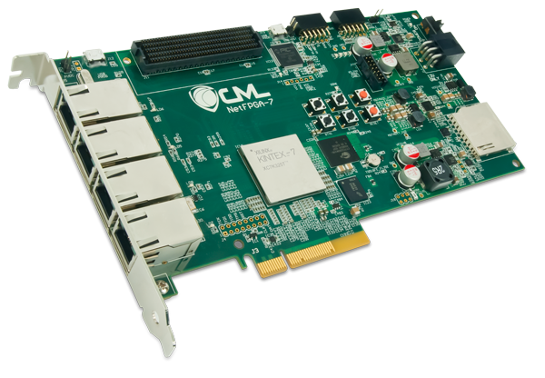
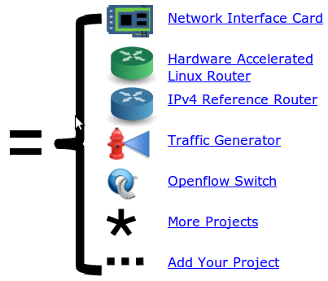
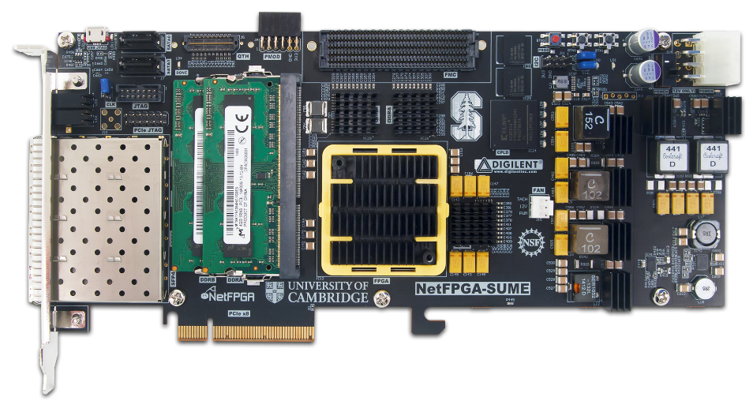
NetFPGA = Networked FPGA
A line-rate, flexible, open networking platform for teaching and research

Slide 93
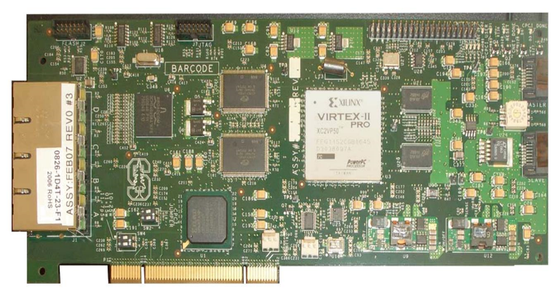
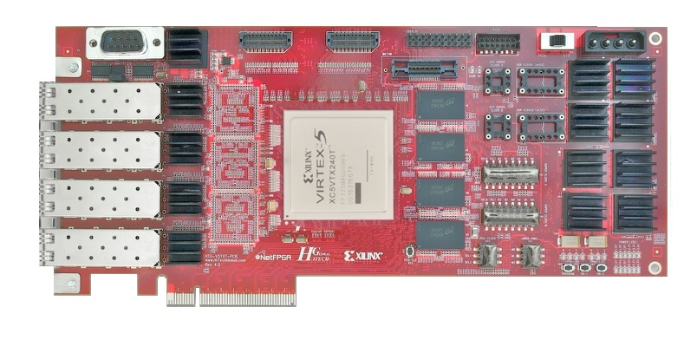

NetFPGA Family of Boards
NetFPGA-1G (2006)
NetFPGA-10G (2010)
NetFPGA-1G-CML (2014)
NetFPGA-SUME (2014)
NetFPGA-1G-CML (2014)
NetFPGA SUME (2014)

Slide 94
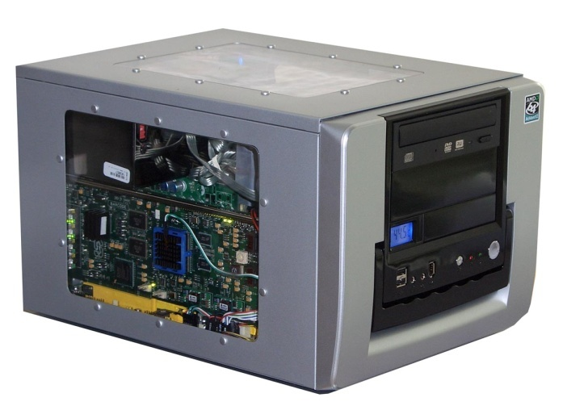

NetFPGA board
Networking Software running on a standard PC
CPU
Memory
PCI-Express
PC with NetFPGA
10GbE
A hardware accelerator built with FPGA driving 1/10/ 100Gb/s network links
FPGA
10GbE
10GbE
Memory
10GbE

Slide 95

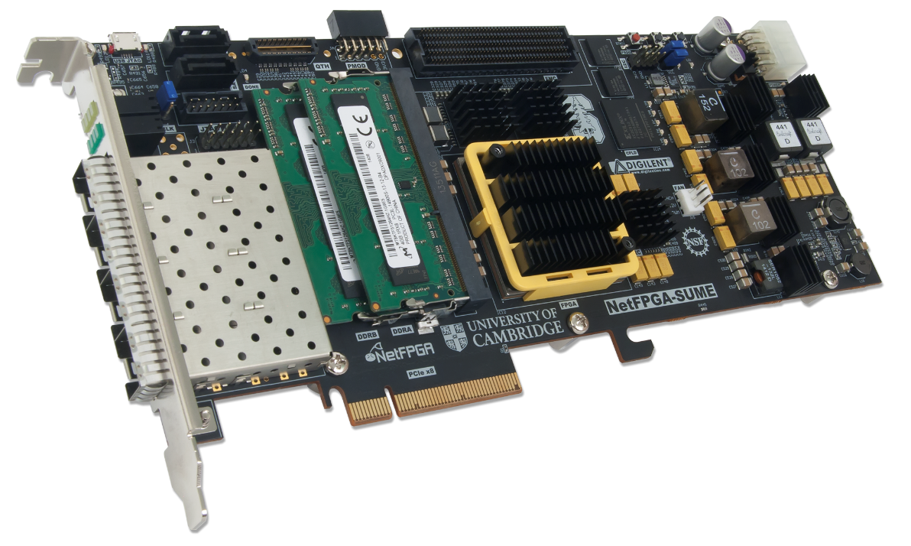
NetFPGA consists of …
Four elements:
NetFPGA board
Tools + reference designs
Contributed projects
Community

Slide 96
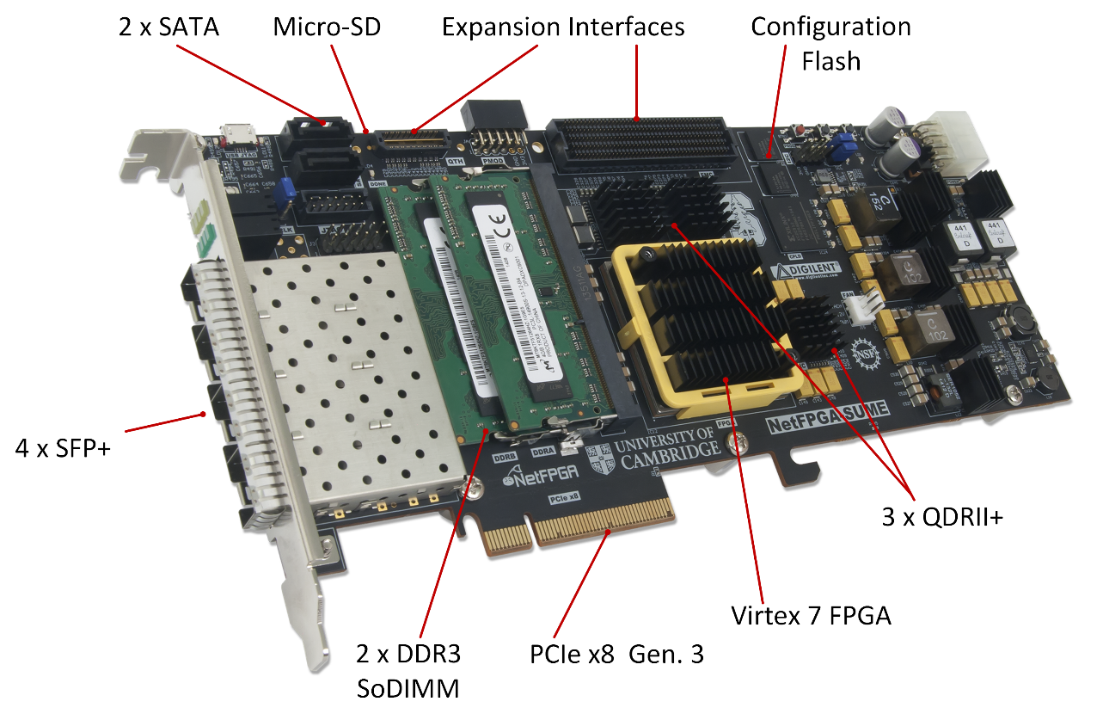
NetFPGA-SUME

Slide 97

Xilinx Virtex 7 690T
Optimized for high-performance applications
690K Logic Cells
52Mb RAM
3 PCIe Gen. 3 Hard cores

Slide 98
Memory Interfaces
DRAM: 2 x DDR3 SoDIMM 1866MT/s, 4GB
SRAM: 3 x 9MB QDRII+, 500MHz

Slide 99
Host Interface
PCIe Gen. 3
x8 (only)
Hardcore IP

Slide 100
Front Panel Ports
4 SFP+ Cages
Directly connected to the FPGA
Supports 10GBase-R transceivers (default)
Also Supports 1000Base-X transceivers and direct attach cables

Slide 101
Expansion Interfaces
FMC HPC connector
VITA-57 Standard
Supports Fabric Mezzanine Cards (FMC)
10 x 12.5Gbps serial links
QTH-DP
8 x 12.5Gbps serial links
Notes:
Some more expansion interfaces for more bandwidth if you're really craving it.

Slide 102
Storage
128MB FLASH
2 x SATA connectors
Micro-SD slot
Enable standalone operation

Slide 103
Full System Components
Software
Application
Driver
nf0
nf1
nf2
nf3
ioctl
PCIe Bus
DMA
Registers
CPU
RxQ
CPU
TxQ
AXI Lite
NetFPGA
user data path
10GE
Tx
10GE
Rx
Ports

Slide 104
Reference Switch Pipeline
Five stages
Input port
Input arbitration
Forwarding decision and packet modification
Output queuing
Output port
Packet-based module interface
Pluggable design
10GE
RxQ
10GE
RxQ
10GE
RxQ
10GE
RxQ
DMA
Input Arbiter
Output Port Lookup
Output Queues
10GE
Tx
10GE
Tx
10GE
Tx
10GE
Tx
DMA

Slide 105

Overview

Slide 106
General Process for Programming a P4 Target
P4->NetFPGA tools
Control Plane
P4 Program
P4 Compiler
Add/remove table entries
Extern control
Packet-in/out
RUNTIME
CPU port
P4 Architecture
Model
Data Plane
Target-specific configuration binary
Tables
Extern
objects
Load
Target
SimpleSumeSwitch
Architecture
NetFPGA SUME

Slide 107
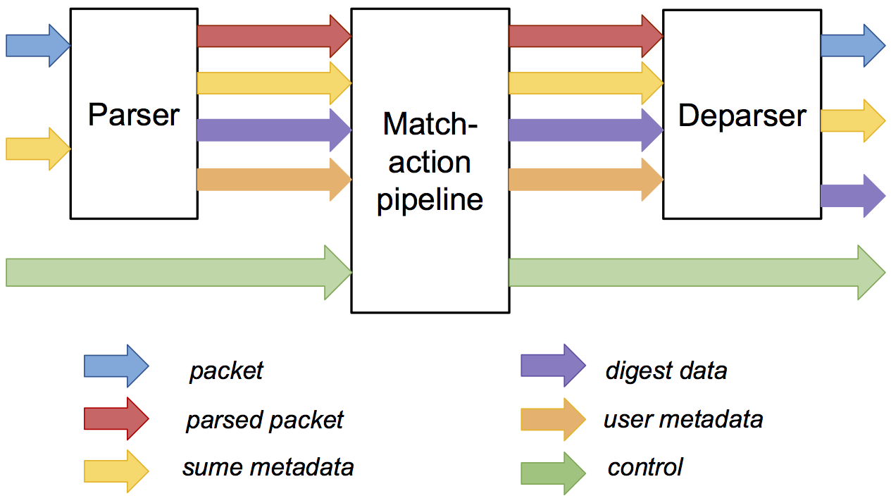
P4→NetFPGA Compilation Overview
NetFPGA Reference Switch
P4 Program
10GE
RxQ
10GE
RxQ
10GE
RxQ
10GE
RxQ
DMA
Xilinx P4₁₆ Compiler
Input Arbiter
Xilinx SDNet Tools
Output Port Lookup
SimpleSume
Switch
SimpleSumeSwitch Architecture
Output Queues
10GE
Tx
10GE
Tx
10GE
Tx
10GE
Tx
DMA
107

Slide 108
SimpleSumeSwitch Architecture Model for SUME Target
tdata
tdata
tuser
tuser
AXI
Lite
AXI
Lite
P4 used to describe parser, match-action pipeline, and deparser
Notes:
Very simple
Can be used to express many pkt processing algs
Parser, M/A, deparsing expressed in P4
User defined metadata: user_meta, digest_data
digest_data can be sent to CP along with packet or by itself
AXI Lite control interface to add/remove table entries, read/write state in any stateful externs

Slide 109
Standard Metadata in SimpleSumeSwitch Architecture
/* standard sume switch metadata */
struct sume_metadata_t {
bit<16> dma_q_size;
bit<16> nf3_q_size;
bit<16> nf2_q_size;
bit<16> nf1_q_size;
bit<16> nf0_q_size;
bit<8> send_dig_to_cpu; // send digest_data to CPU
bit<8> dst_port; // one-hot encoded
bit<8> src_port; // one-hot encoded
bit<16> pkt_len; // unsigned int
}
*_q_size – size of each output queue, measured in terms of 32-byte words, when packet starts being processed by the P4 program
src_port/dst_port – one-hot encoded, easy to do multicast
user_metadata/digest_data – structs defined by the user

Slide 110
P4→NetFPGA Extern Function library
Implement platform specific functions
Black box to P4 program
Implemented in HDL
Stateless – reinitialized for each packet
Stateful – keep state between packets
Xilinx Annotations
@Xilinx_MaxLatency() – maximum number of clock cycles an extern function needs to complete
@Xilinx_ControlWidth() – size in bits of the address space to allocate to an extern function
Notes:
Externs are devices whose functionality is not
For P4->NetFPGA they are implemented in HDL

Slide 111
P4→NetFPGA Extern Function library
HDL modules invoked from within P4 programs
Stateful Atoms [1]
Stateless Externs
Add your own!
Atom | Description
R/W | Read or write state
RAW | Read, add to, or overwrite state
PRAW | Predicated version of RAW
ifElseRAW | Two RAWs, one each for when predicate is true or false
Sub | IfElseRAW with stateful subtraction capability
Atom | Description
IP Checksum | Given an IP header, compute IP checksum
LRC | Longitudinal redundancy check, simple hash function
timestamp | Generate timestamp (granularity of 5 ns)
[1] Sivaraman, Anirudh, et al. "Packet transactions: High-level programming for line-rate switches." Proceedings of the 2016 ACM SIGCOMM Conference. ACM, 2016.
Notes:
In order to avoid making user always write their own
P4->NetFPGA takes a different approach than V1 Arch to expose stateful externs
Because all read/modify/write operations must be atomic for each pkt
Not a problem for V1 arch because single thread in SW
P4->NetFPGA provides set of stateful atoms that each perform some read/modify/write operation atomically
Also some useful stateless externs
Very important that user be able to add their own easily

Slide 112
Using Atom Externs in P4 – Resetting Counter
Packet processing pseudo code:
count[NUM_ENTRIES];
if (pkt.hdr.reset == 1):
count[pkt.hdr.index] = 0
else:
count[pkt.hdr.index]++
Notes:
example of how to use a stateful atom

Slide 113
Using Atom Externs in P4 – Resetting Counter
#define REG_READ 0
#define REG_WRITE 1
#define REG_ADD 2
// count register
@Xilinx_MaxLatency(1)
@Xilinx_ControlWidth(3)
extern void count(in bit<3> index, in bit<32> newVal,
in bit<32> incVal,in bit<8> opCode,
out bit<32> result);
bit<16> index = pkt.hdr.index;
bit<32> newVal; bit<32> incVal; bit<8> opCode;
if(pkt.hdr.reset == 1) {
newVal = 0;
incVal = 0; // not used
opCode = REG_WRITE;
} else {
newVal = 0; // not used
incVal = 1;
opCode = REG_ADD;
}
bit<32> result; // the new value stored in count reg
count_reg_raw(index, newVal, incVal, opCode, result);
State can be accessed exactly 1 time
Using RAW atom here
Instantiate atom
Set metadata for state access
Single state access!

Slide 114
API & Interactive CLI Tool Generation
Both Python API and C API
Manipulate tables and stateful elements in P4 switch
Used by control-plane program
CLI tool
Useful debugging feature
Query various compile-time information
Interact directly with tables and stateful elements in at run time

Slide 115
P4→NetFPGA Workflow
Write P4 program
Write externs
Write python gen_testdata.py script
Compile to Verilog / generate API & CLI tools
Run simulations
Build bitstream
Check implementation results
Test the hardware
All of your effort will go here
fail
pass

Slide 116
Get the Tools!
Docs: https://github.com/NetFPGA/P4-NetFPGA-public/wiki
Request P4->NetFPGA tools and licenses from Xilinx
NetFPGA SUME Board
(Academic users) Special price request [1]
(Industry users) Purchase from Digilent [2]
[1] https://netfpga.wufoo.com/forms/netfpga-special-pricing-request/
[2] http://store.digilentinc.com/netfpga-sume-virtex-7-fpga-development-board/

Slide 117
Future research topics

Slide 118
Examples of ongoing P4 Research Topics
P4 Infrastructure
Programmable scheduling
Programmable target architectures
PacketMod
Data-plane Programs
In-band network telemetry
Congestion control
Load balancing
Networking-Offloading Applications
Aggregation for MapReduce applications
Key-value caching
Consensus

Slide 119
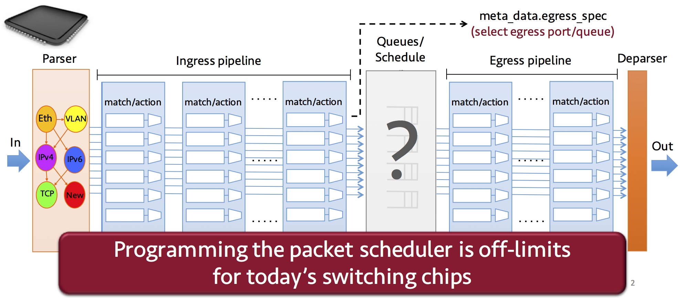
Programmable Scheduling
Sivaraman, Anirudh, et al. "Programmable packet scheduling at line rate." Proceedings of the 2016 ACM SIGCOMM Conference. ACM, 2016.
Notes:
Work initially proposed at SIGCOMM a couple years ago
The scheduler (or TM) is only part of modern programmable switch that is not programmable today
Can program Parser, M/A, Deparser in P4

Slide 120
Why scheduler is not programmable ... so far
Plenty of scheduling algorithms, but no consensus on right abstractions. Contrast to:
Parse graphs for parsing
Match-Action tables for forwarding
Scheduler has tight timing requirements
One decision every few ns

Slide 121
What does the Scheduler do?
Decides:
In what order are packets sent?
Ex: FCFS, Priorities, WFQ
At what time are packets sent?
Key observation:
For many algorithms, the relative order in which packets are sent does not change with future arrivals
i.e. scheduling order can be determined before enqueue

Slide 122
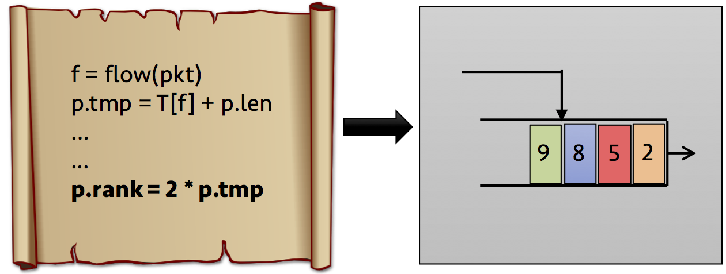
PIFO
PIFO - proposed abstraction that can be used to implement many scheduling algorithms
Packets are pushed into an arbitrary location based on computed rank
Rank Computation
PIFO scheduler
(programmable)
(fixed logic)
Notes:
PIFO is the proposed abstraction...
Stands for ...
PIFO has been around for a while, initially proposed as a theoretical proof construct for proving properties about classes of scheduling algs
Recently realized that it is a useful abtraction for HW implementation too
PIFO consists of ...

Slide 123
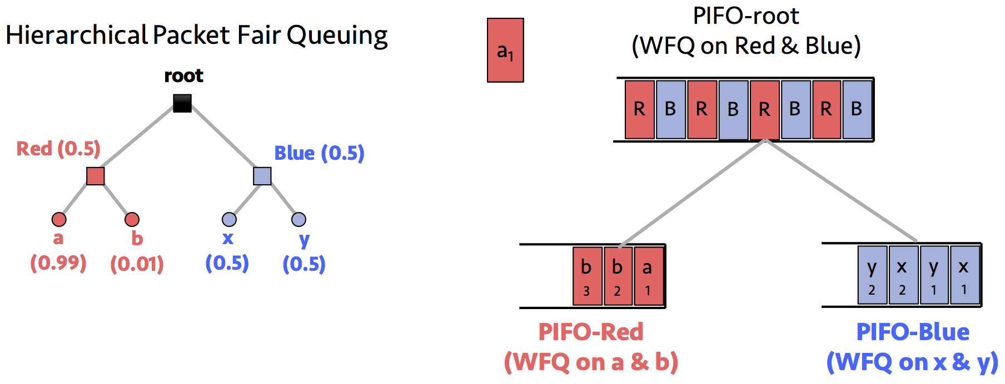
PIFO Tree

Slide 124
PIFO Remarks
Very limited scheduling in modern switching chips
Deficit Round Robin, traffic shaping, strict priorities
Scheduling algorithms that can be implemented with PIFO
Weighted Fair Queueing, Token Bucket Filtering, Hierarchical Packet Fair Queueing, Least-Slack Time-First, the Rate Controlled Service Disciplines, and fine-grained priority scheduling (e.g., Shortest Job First)
PIFO cannot implement algorithms that require
Changing the scheduling order of all packets of a flow
Output rate limiting
PIFO implementation feasibility?

Slide 125
Programmable Target Architectures
Observations:
Current P4 expectation: target architectures are fixed, specified in English
FPGAs can support many different architectures
Idea:
Extend P4 to allow description of target architectures
More precise definition than English description
Generate implementation on FPGA
Easily integrate custom modules
Explore performance tradeoffs of different architectures

Slide 126
Many Possible Architectures…
SimpleSumeSwitch
Parser
M/A
Deparser
Output
Queues
V1 Model
Parser
M/A
TM
M/A
Deparser
Output
Queues
Portable Switch Architecture
Parser
M/A
Deparser
TM
Parser
M/A
Deparser
Output
Queues

Slide 127
Many Possible Architectures…
Custom Traffic Manager
Parser
M/A
My
TM
M/A
Deparser
Output
Queues
Pkt Gen
Programmable Packet Generator
Parser
M/A
TM
M/A
Deparser
Output
Queues

Slide 128
Programmable Target Architectures
package SimpleSumeSwitch<H, M, D>(
Parser<H, M, D> TopParser,
Pipe<H, M, D> TopPipe,
Deparser<H, M, D> TopDeparser) {
// Top level I/O
packet_in instream;
inout sume_metadata_t sume_metadata;
out D digest_data;
packet_out outstream;
// Connectivity of the architecture
connections {
// TopParser input connections
TopParser.b = instream;
TopParser.sume_metadata = sume_metadata;
// TopPipe <-- TopParser
TopPipe.p = TopParser.p;
TopPipe.user_metadata = TopParser.user_metadata;
TopPipe.digest_data = TopParser.digest_data;
TopPipe.sume_metadata = TopParser.sume_metadata;
// TopDeparser <-- TopPipe
TopDeparser.p = TopPipe.p;
TopDeparser.user_metadata = TopPipe.user_metadata;
TopDeparser.digest_data = TopPipe.digest_data;
TopDeparser.sume_metadata = TopPipe.sume_metadata;
// TopDeparser output connections
digest_data = TopDeparser.digest_data;
sume_metadata = TopDeparser.sume_metadata;
outstream = TopDeparser.b;
}
}

Slide 129
Workflow
Two Actors: (1) Target Architecture Designer, (2) P4 Programmer
Provides:
P4₊ architecture declaration
Implements:
non-P4 elements
externs
in target architecture
Someone who is more familiar with FPGA development

Slide 130
Workflow
Two Actors: (1) Target Architecture Designer, (2) P4 Programmer
Implementation of P4 elements
P4₊ architecture description
Compile to PX
Compile to PX
PX subsystems
Partial PX System
Complete PX System
Compile to Verilog
HDL switch design
130

Slide 131
In-band Network Telemetry (INT)
“I visited: switch 1 @ 780ns,
switch 9 @ 1.3us,
switch 12 @ 2.4us
1
Which path did my packet take?
# | Rule
1
2
3
…
75 | 192.168.0 /24
…
“In switch 1, I followed rules 75 and 250.In switch 9, rules 3 and 80”
2
Which rules did my packet follow?
INT Slides courtesy of Nick McKeown

Slide 132
In-band Network Telemetry (INT)
“Delay: 100ns, 200ns, 19740ns”
3
How long did my packet queue at each switch?
Queue
4
Who did my packet share the queue with?
Time
INT Slides courtesy of Nick McKeown

Slide 133
In-band Network Telemetry (INT)
1
Which path did my packet take?
2
Which rules did my packet follow?
3
How long did my packet queue at each switch?
4
Who did my packet share the queue with?
No need to add a single additional packet!
INT Slides courtesy of Nick McKeown

Slide 134
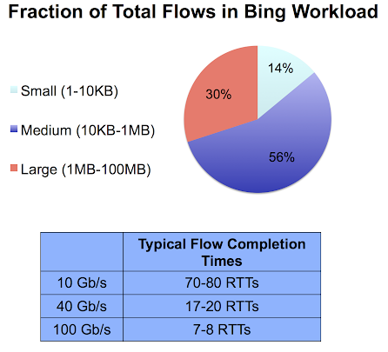
Congestion Control
Reactive Congestion Control
Adjust Flow
Rate
Measure
Congestion
No use of explicit information about traffic matrix
Can only react and move in right direction
Reactive techniques are slow to converge (10s-100s of RTTs)
Typical flows will finish in just a few RTTs as we move towards higher link speeds
Notes:
congestion control is all about deciding how to allocate the network's scare resources amongst the contending flows
It generally tries to maximize throughput of all flows while keeping latencies low
For a long time, congestion control has been implemented primarily in the end hosts, however, the rise of programmable network devices provides a compelling reason to move some of that functionality into the network infrastructure
I think this makes a lot of sense because the network is the only place that really knows it's current congestion status, it's current state

Slide 135
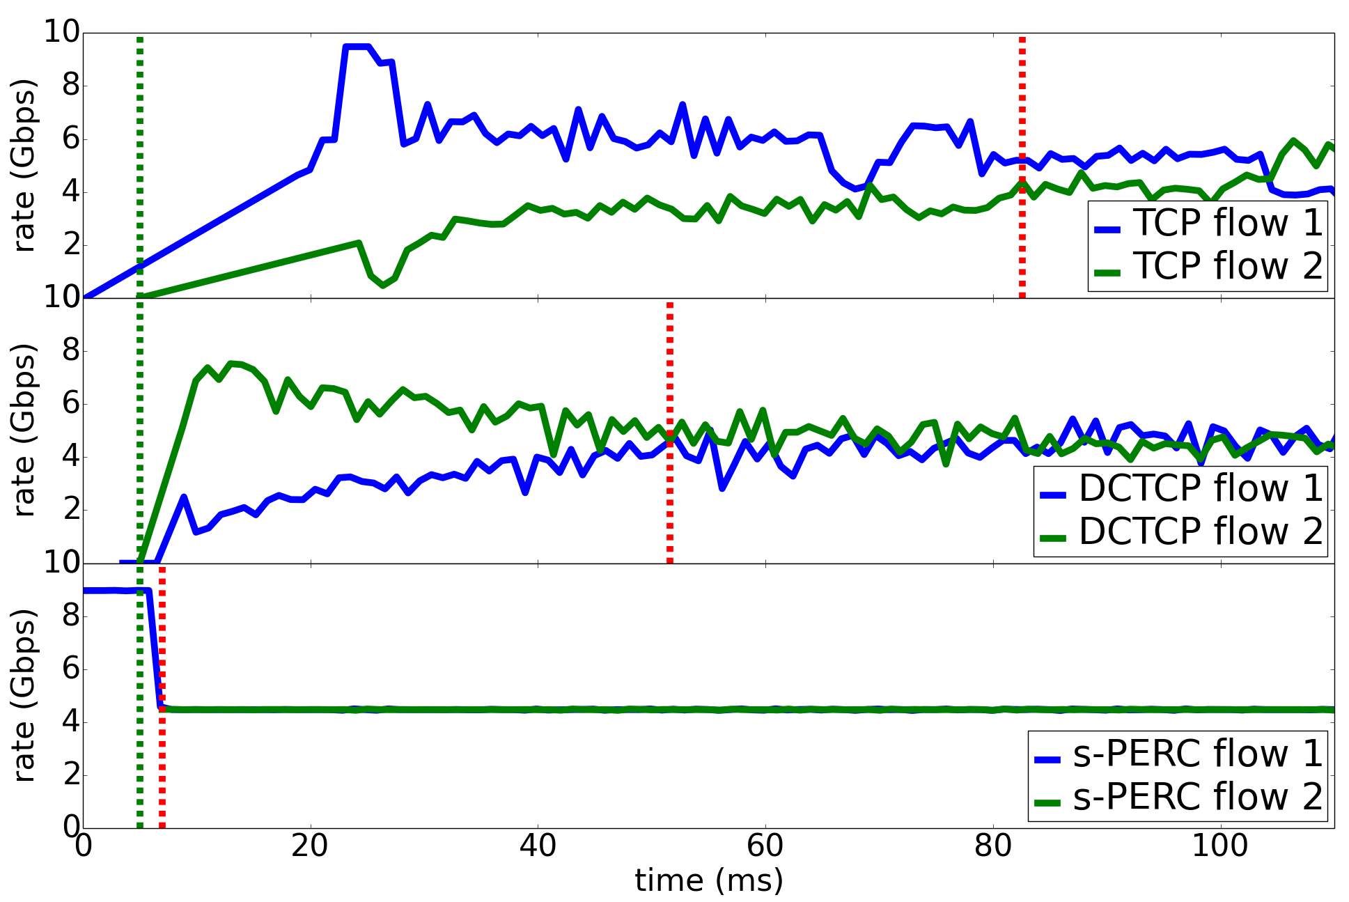
Proactive Congestion Control
Proactive techniques converge much more quickly than reactive
Faster convergence times lead to lower flow completion times
10 Gbps
Reactive
Proactive
proactive
proactive

Slide 136
An example proactive scheme
10 Gb/s link
Flow A
Sending host adjusts sending rate
Switch Computation
N = 1 flow
C = 10Gb/s
Fair share = C/N = 1 Gb/s
Switch Computation
N = 1 flow
C = 10Gb/s
Fair share = C/N = 1 Gb/s
Control Packet
Per-flow state:
BW demand
Current bottleneck
Per-link state

Slide 137
An example proactive scheme
10 Gb/s link
Flow A
Flow B
Switch Computation
N = 2 flow
C = 10 Gb/s
Fair share = C/N = 5 Gb/s

Slide 138
Proactive Algorithm in P4
Set low priority
not ctrl pkt
L2 Forwarding Logic
Priority Output Queues
Set high priority
is ctrl pkt
Read/update link state
Compute fair share rate
Set bandwidth demand

Slide 139
In-Network Computation
Programmable data plane hardware → opportunity to reconsider division of computation
What kinds of computation should be delegated to network?
Network computations are constrained:
Limited memory size (10’s of MB of SRAM)
Limited set of actions (simple arithmetic, hashing, table lookups)
Few operations per packet (10’s of ns to process each packet)
Goals:
Reduce: application runtime, load on servers, network congestion
Increase: application scalability
Sapio, Amedeo, et al. "In-Network Computation is a Dumb Idea Whose Time Has Come." Proceedings of the 16th ACM Workshop on Hot Topics in Networks. ACM, 2017.

Slide 140
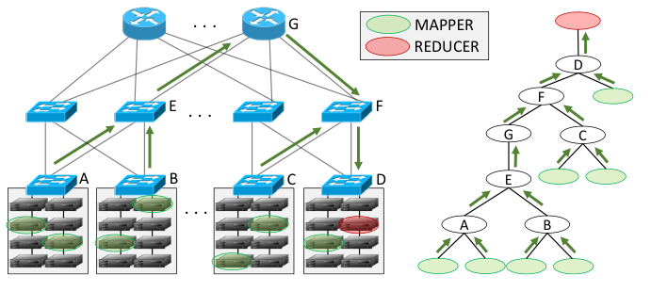
In-Network Aggregation
Aggregate data at intermediate network nodes to reduce network traffic
Simple arithmetic operations at switches
Widely applicable to many distributed applications
Machine learning training
Graph analytics
MapReduce applications

Slide 141
In-Network Aggregation
Network controller is informed of MapReduce job
Configures switches in aggregation tree to perform aggregation
Significant network traffic reduction → reduced run time
How to make robust to loss? Encryption?
Aggregation Tree
Reduction Results

Slide 142
Two relevant papers at FPGA 2018
16:50 Monday | P4-compatible High-level Synthesis of Low Latency 100 Gb/s Streaming Packet Parsers in FPGAs (short paper)
 | Jeferson Santiago da Silva; François-Raymond Boyer; J.M. Pierre Langlois (Polytechnique Montreal)
15:15 Tuesday | Configurable FPGA Packet Parser for Terabit Networks with Guaranteed Wire-Speed Throughput
 | Jakub Cabal (1); Pavel Benáček (1); Lukáš Kekely(1); Michal Kekely (2); Viktor Puš (2); Jan Kořenek (3) (1 CESNET a.l.e.; 2 Netcope Technologies ; 3 Brno Unive of Tech)

Slide 143
The P4 Language Consortium
http://p4.org
Consortium of academic and industry members
Open source, evolving, domain-specific language
Permissive Apache license, code on GitHub today
Membership is free: contributions are welcome
Independent, set up as a California nonprofit
Notes:
From the very beginning, P4 was a public, open project, governed by an independent California non-profit P4 Language Consortium, also known as P4Lang.
All the code is on GiHub under the very permissive Apache License
The membership in the consortium is free: everyone is welcome to join and contribute.

Slide 144




















































P4.org current membership
Original P4 Paper Authors:
Operators/
End Users
Systems
Targets
Solutions/ Services
Academia/
Research

Slide 145
The end …
… over to you now

